Slide 1

Component Library
User Manual
Version 1.0

Slide 2
Table of Contents:
Introduction
System Architecture (To be added)
User Flows
Materials
Services
Rate – Material & Service
SFGs
Packages
Exchange Rates
Price Book:
CPR

Slide 3
Introduction
Component Library
Component Library provides TE a central repository for all the Component information, their Rates and CPR (Cost to Price ratio) by eliminating the manual processes to manage this data; and supports other TE enterprise systems for their respective procurement/estimation/planning/customization activities
Component Types
Materials
Asset properties
Brands
Services
SFGs
Packages

Slide 4
Access Component Library
Steps:
URL:
User Credentials: TE Active Directory Credentials of the user
Ex:

Slide 5
Materials

Slide 6
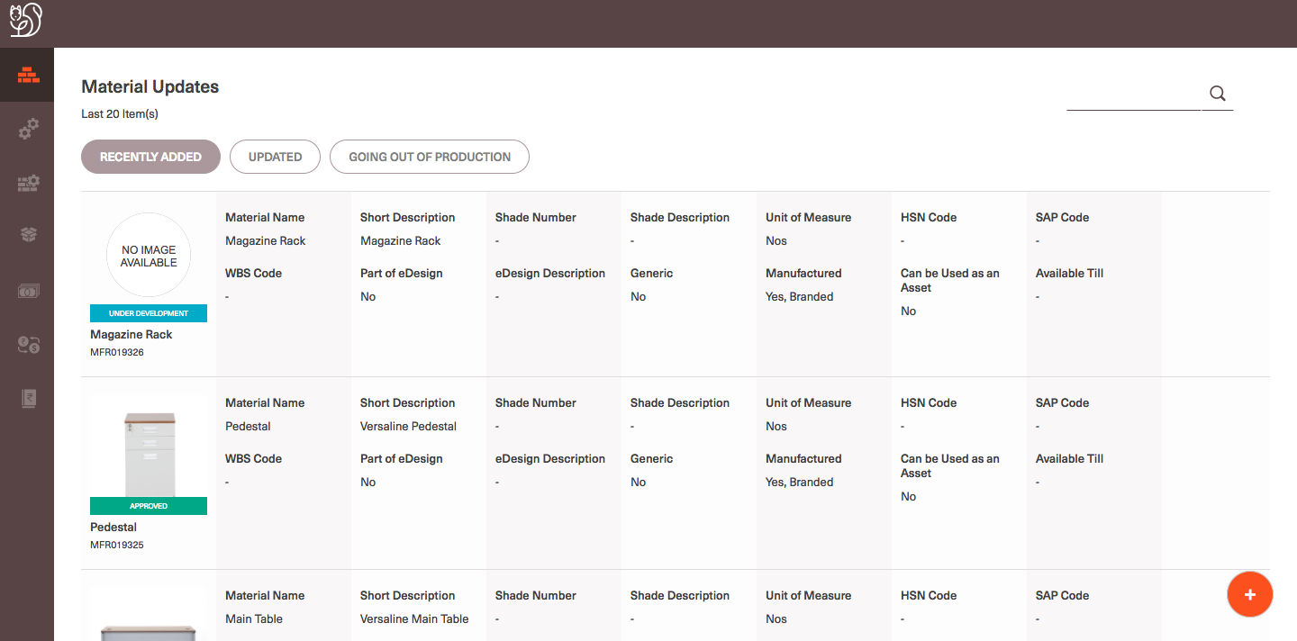
Recently added materials:
Steps:
Log in to Component Library(CL) with Active Directory credentials.
System navigates users to Materials Home page.
On Home page Recently added 20 items are displayed with the basic details of the material as shown in the below.

Slide 7
Search for a material:
Steps:
Log in to Component Library(CL) with Active Directory credentials.
On Material Homepage enter the required Keyword on the Search bar (at the top right side of the page).
System shall prompt the user with all the Material Groups among which the search results are found.
Select the respective Material Group in which the search results are required.
System shall display all the search results for the given keyword in the specified Material Group.
The default set of Material properties that are accessible for users are General properties of all the materials in search results.
By default all the search results are sorted by Material Name
Users can select the required set of Material properties and navigate to the same for all the materials in the search results.
Users can Sort and Filter the search results with all the properties of the respective material group.

Slide 8
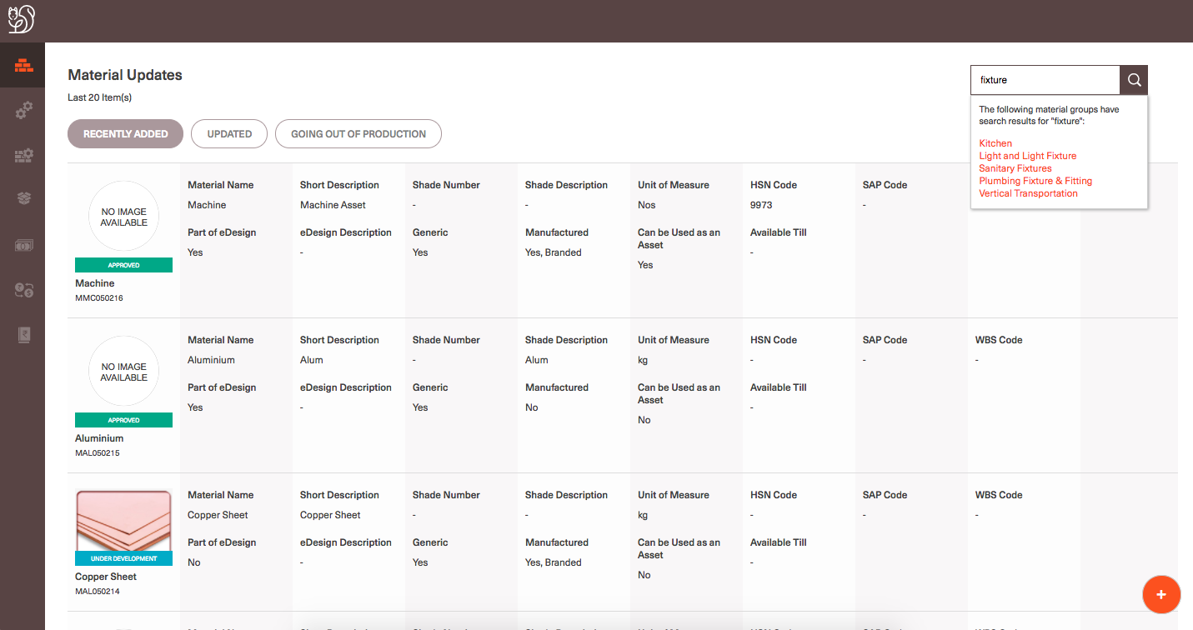
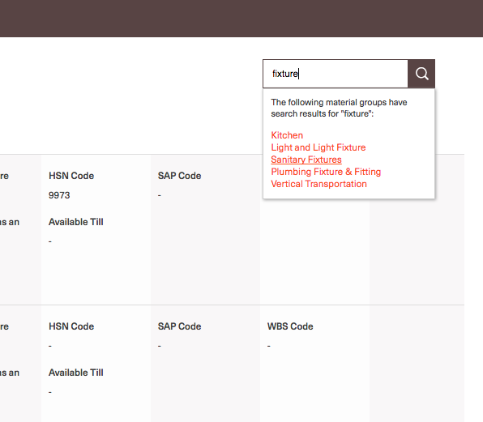
Search bar
Select the required Material Group

Slide 9
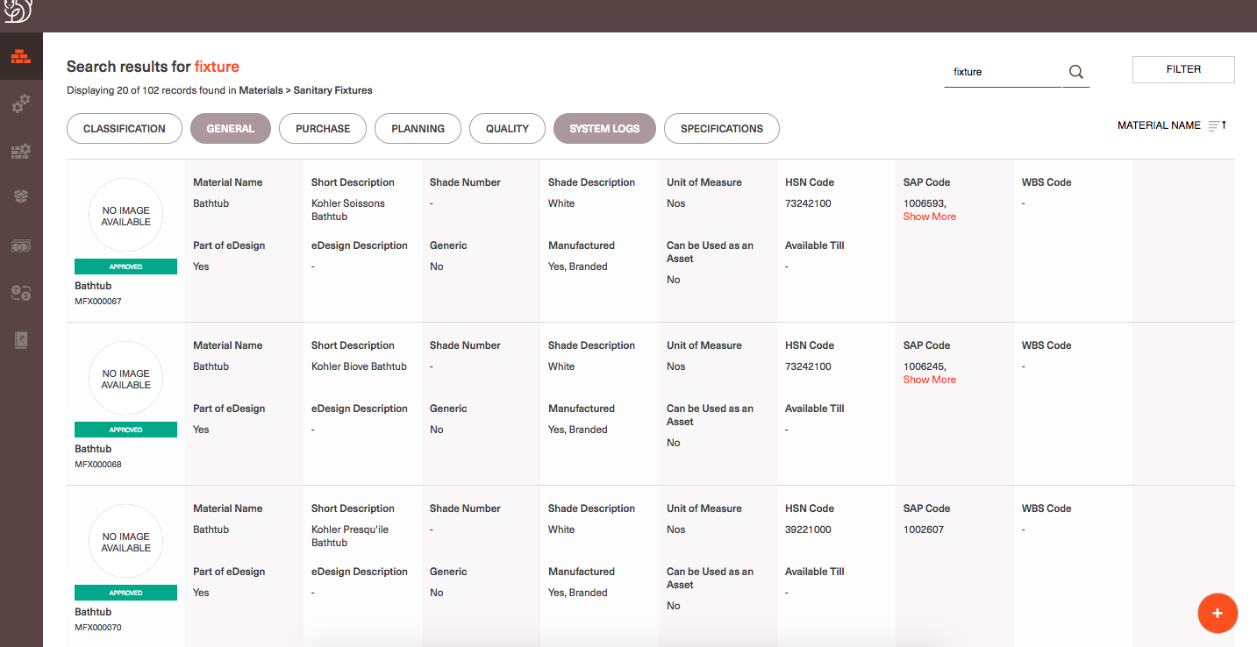
By Default General properties of materials will be displayed in search results page

Slide 10
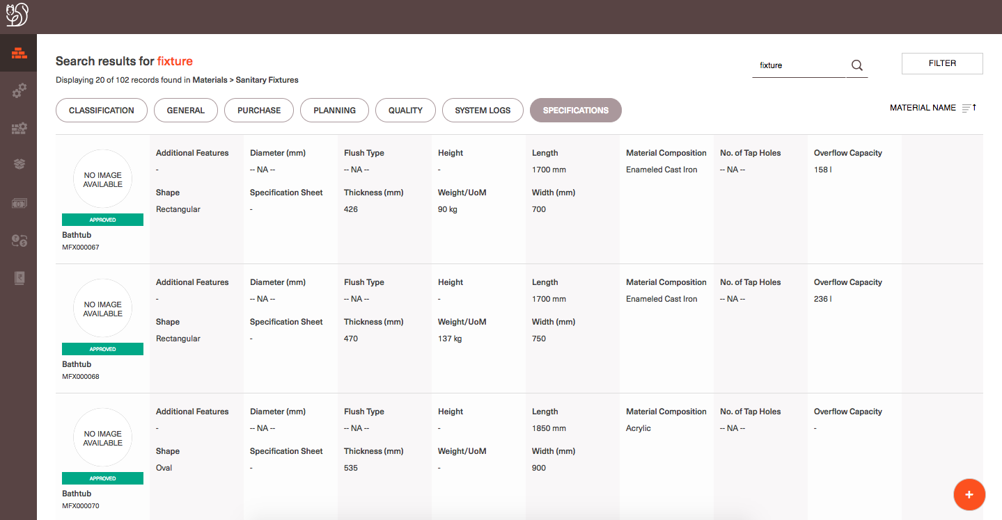
Filters
Select any Material properties tab and view the respective details of all the materials in search results
Sorting.
Search results are sorted default w.r.t. Material name in Ascending order

Slide 11
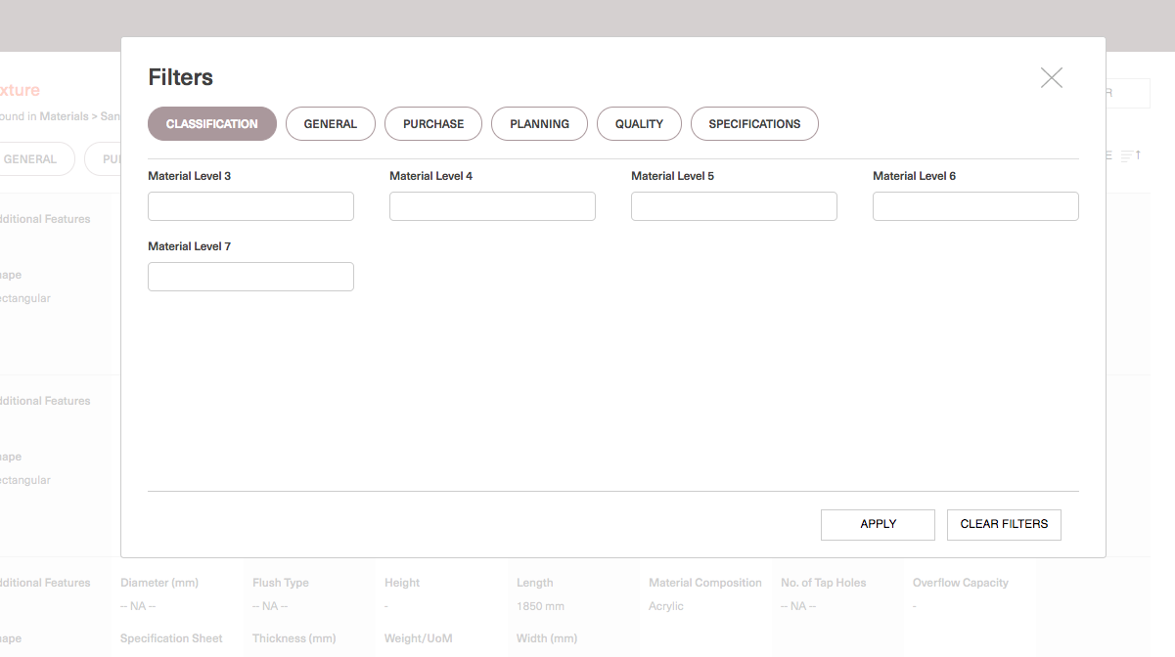
Filters in Material Search results page

Slide 12
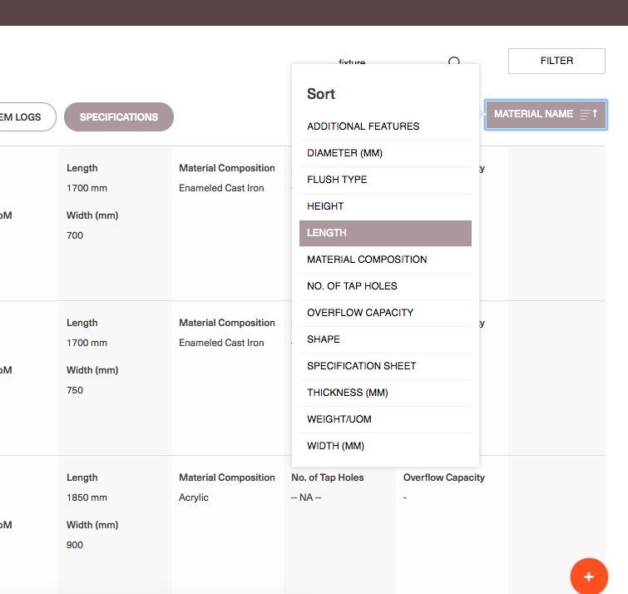
Sorting Material search results

Slide 13
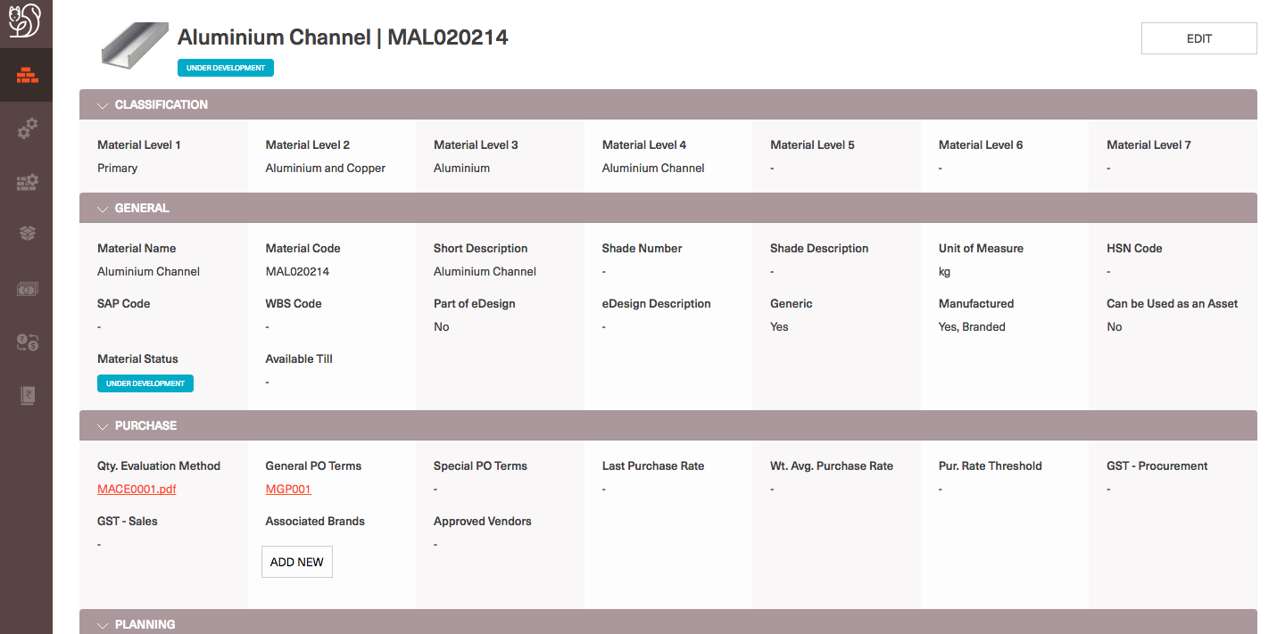
View material details
Log in to CL and search for the required material using the search bar on the materials homepage.
Select the required material from search results page.
System navigates users to Material details page of the specified material.

Slide 14
View linked files associated with a material:
Log in to CL and search for the required material using the search bar on the materials homepage.
Select the required material from search results page.
System navigates users to Material details page of the specified material.
Select the required linked file by clicking on the link displayed against the column details. (Ex: Qty. Evaluation method for the below displayed material has a PDF documented with file name MACE001.
The respective linked document opens up in the next tab and users can
Checklist:
Checklists are templated with the footer and header, and the content of the Checklist is saved as data associated to the respective material.
As of today on CL DB the following checklist templates are setup
Globally:
PO Terms
General Terms
Materials
Inspection Checklist
Specifications Sheet
Static files:
Globally:
Image
Qty. Evaluation Method
Storage Method
Sampling Method
Technical Drawing
Maintenance Checklist
Manufacturer's Specification

Slide 15
Linked file for respective field
Linked file for respective field

Slide 16
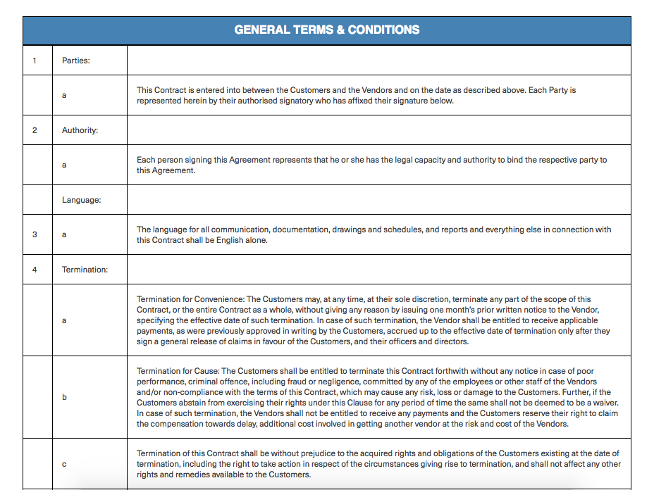
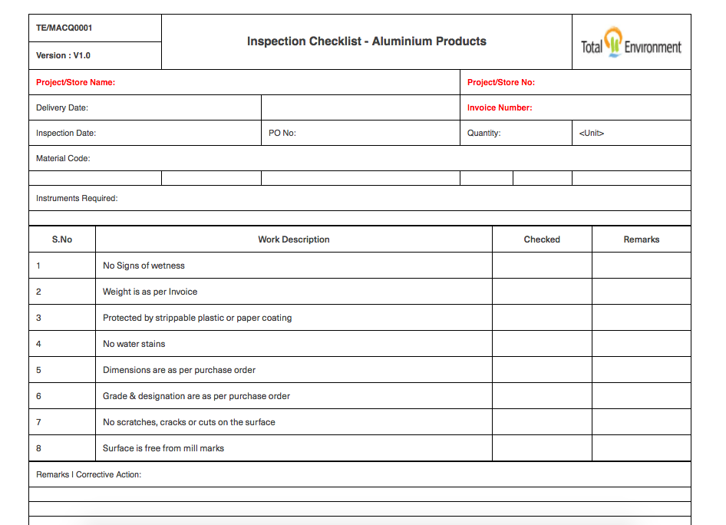
Sample Checklist

Slide 17
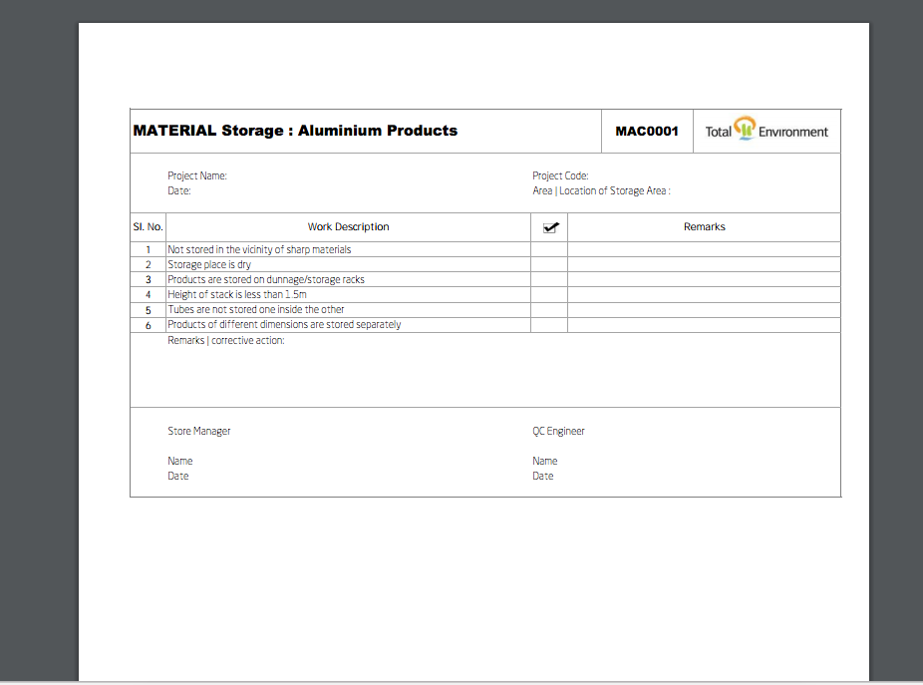
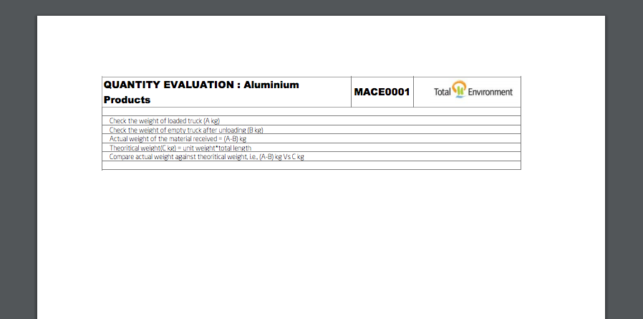
Sample PDF file

Slide 18
View material details
Log in to CL and search for the required material using the search bar on the materials homepage.
Select the required material from search results page.
System navigates users to Material details page of the specified material.

Slide 19
Create a material
Log into CL and navigate to Materials homepage or search results for material
Click on the ‘+’ at the bottom of the page and application will navigate users to ‘Add new material’ page
Define which group of material to be created by setting the values at Material level 1 and level 2
As user selects the material level 2 value, the rest of the properties for the material in the defined group shall load and user can fill in all the details before submitting them
Below are the list of Mandatory fields user needs to fill to create material:
Material name, Short Description, Unit of Measure, Material Status, Part of eDesign, Generic, Manufactured, Can be used as an Asset?.

Slide 20
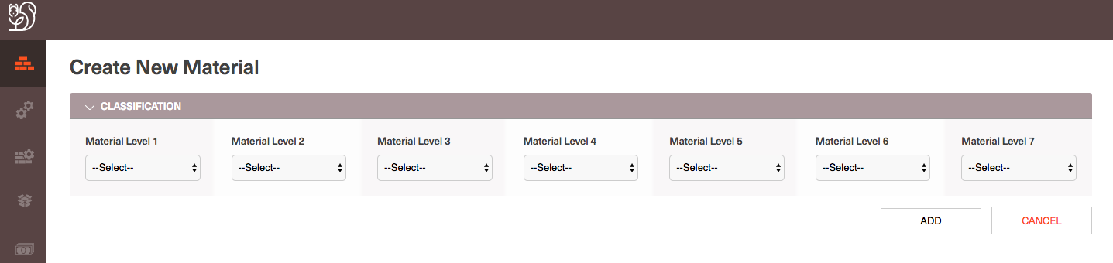
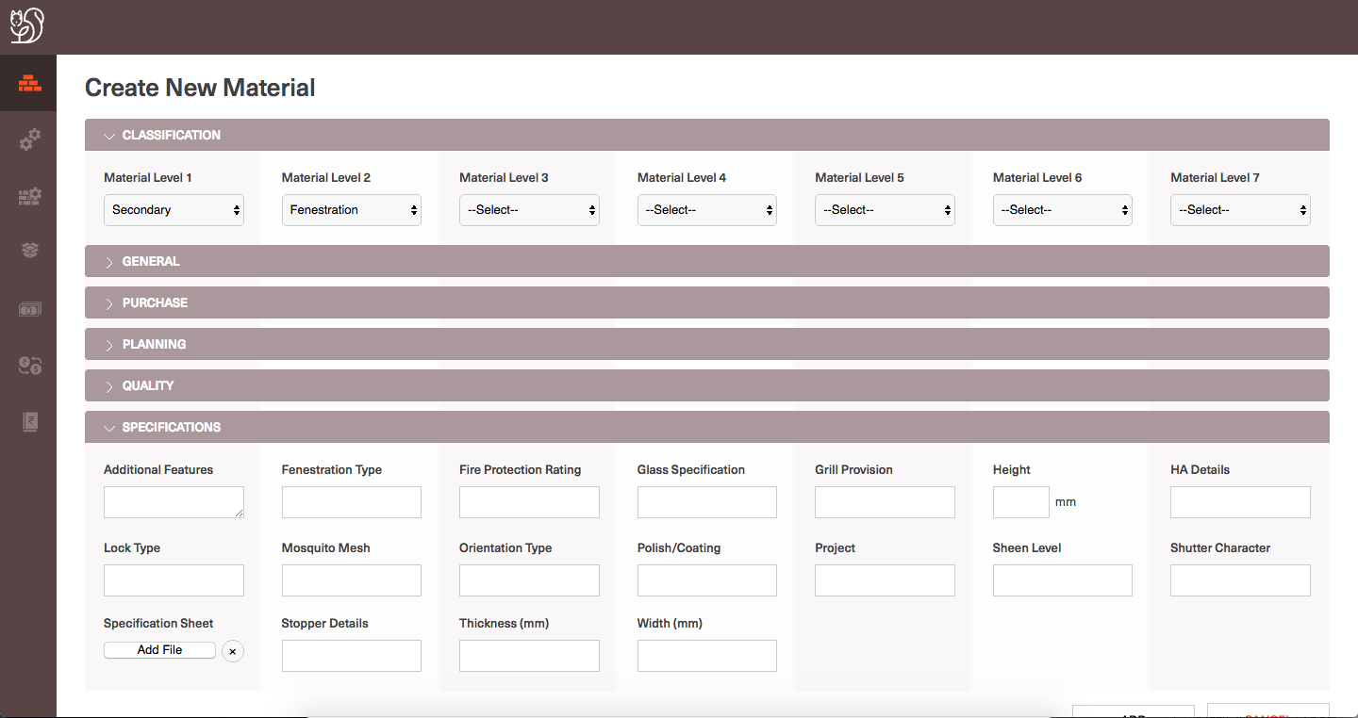
Define Classification level 1 and level 2 for the new material
Specification properties and rest of the properties will load based on the Material level 2 defined

Slide 21
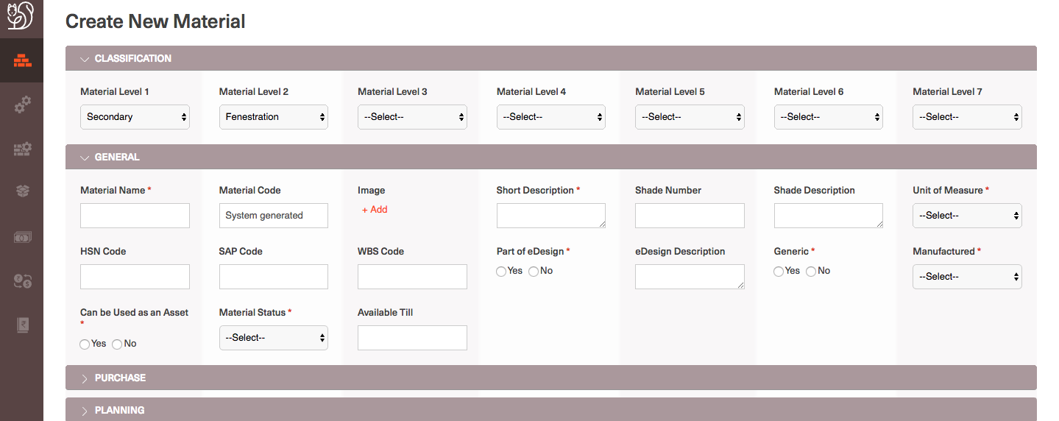
All the mandatory fields are marked with *
Click on Add to add Image

Slide 22
Upload or attach files to a material
Log into CL and navigate to Materials homepage or search results for material
Navigate to Material detail page for the specific material
Select ‘Edit' and Navigate to the specific property for which a file needs to be uploaded/attaches
If there is no file already linked you will find ‘Add’ button next to that material property
If there is a file already linked and only one file at a time is allowed in that property you will find a delink button for that file where you can delink that existing file and ‘Add’ another.
Click on ‘Add’
User can either upload a new file
Select ‘Browse’ from the local system drive and upload the file as needed
System will warn the user if the file they are trying to upload is not of valid format
Search for an existing file and link it to the material
User can search an existing file based on the other material for which the file is linked.
Search can be done with Material name/code
Against the search results ‘Link’ button supports users to select the right file they wish to link
In the process users can actually select the file link and view the file on the next tab/window to determine the right file.

Slide 23
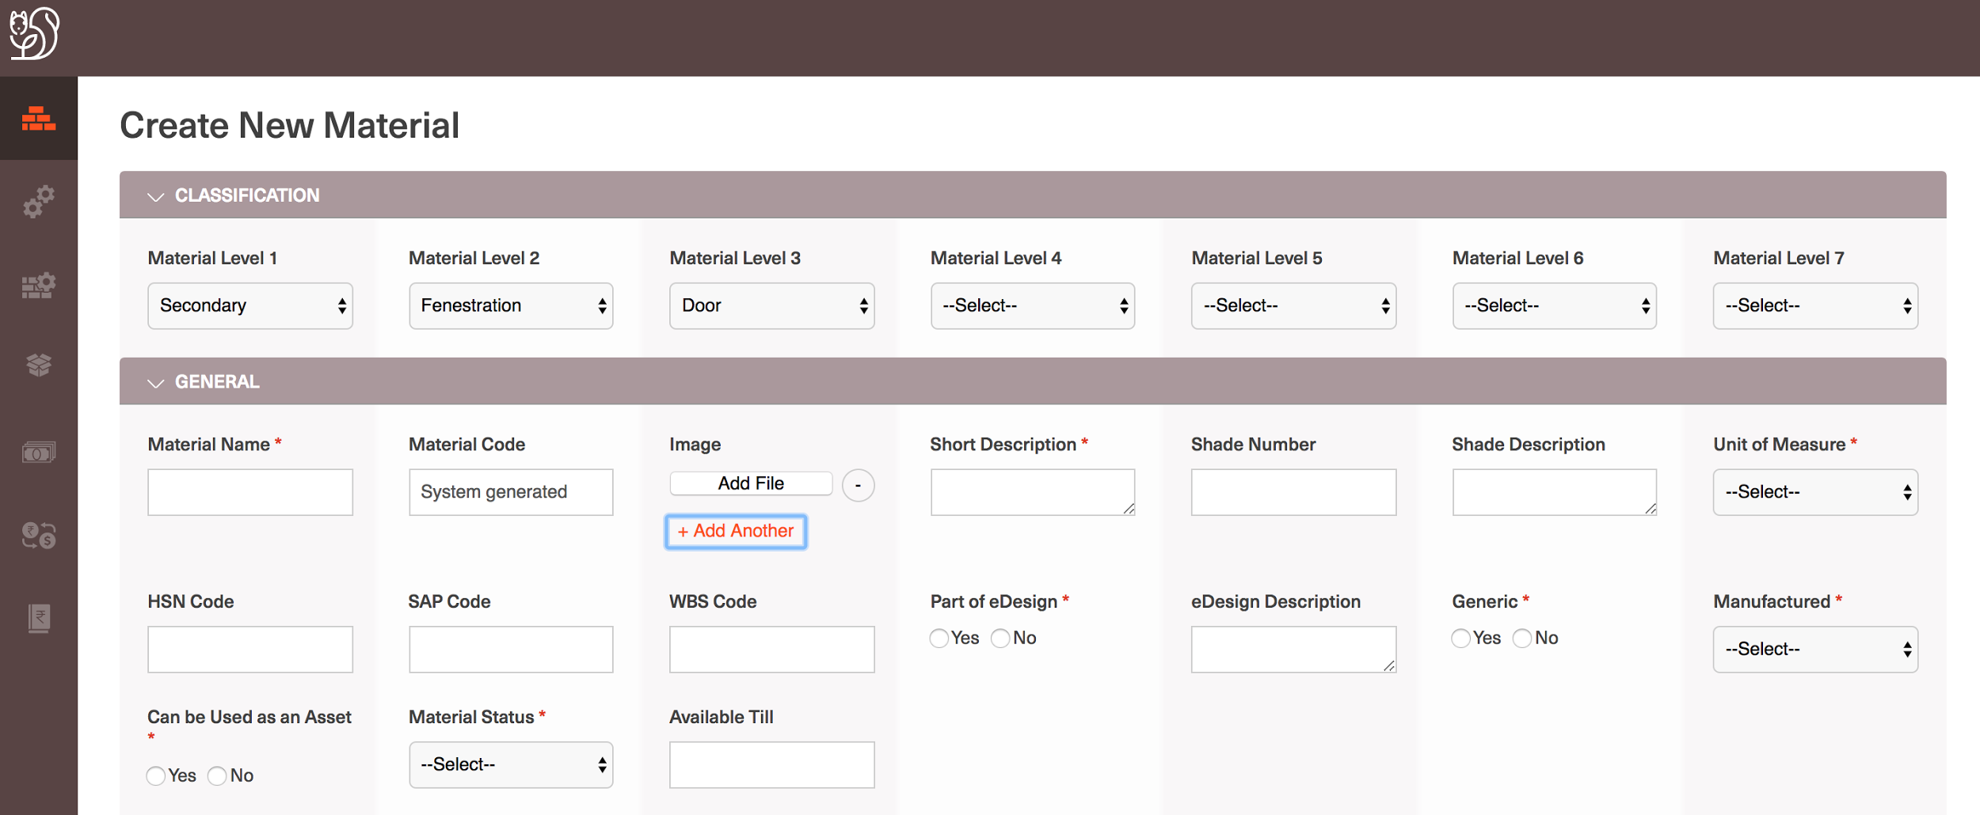
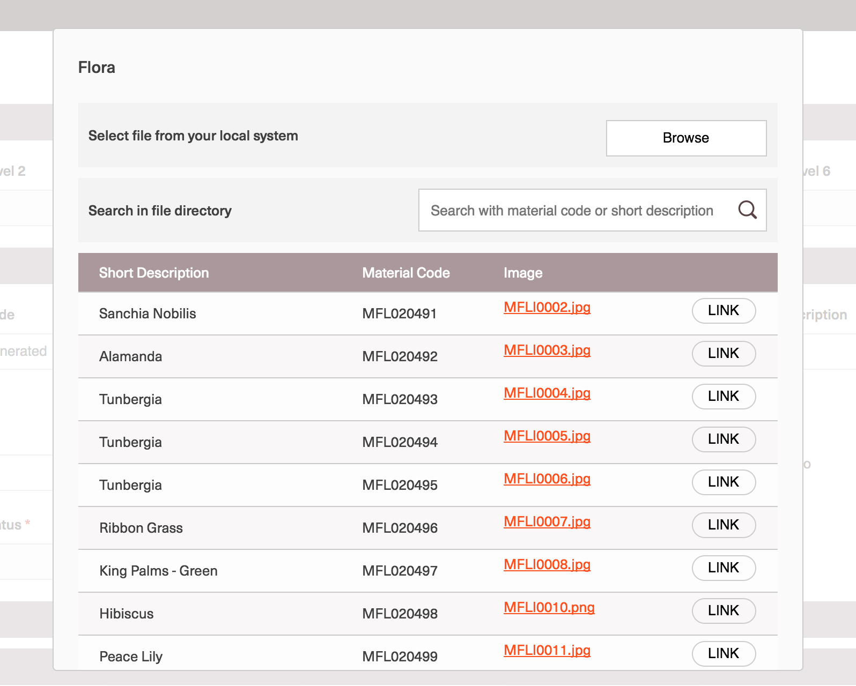
On the pop-up , Browse and add a new File
Click on Add File
Or, Link any of the existing File

Slide 24
Update a material details
Log into CL and navigate to Materials homepage or search results for material
Navigate to Material detail page for the specific material
Select ’Edit’ on the top right corner of the page
View all the material properties in editable fashion
Users can update the required details except for the non-editable fields values like: Material code, System logs, Last Purchase Rate and Wt. Avg. Purchase Rate
User should ’Update’ after makes the required changes to persist the changes onto the CL DB

Slide 25
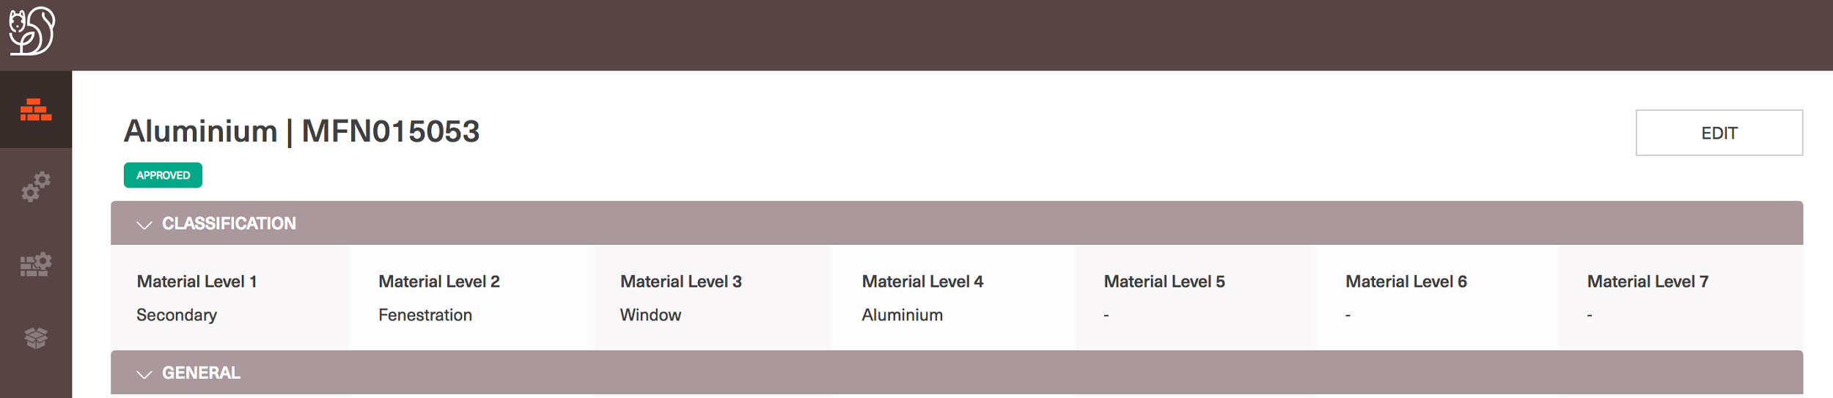
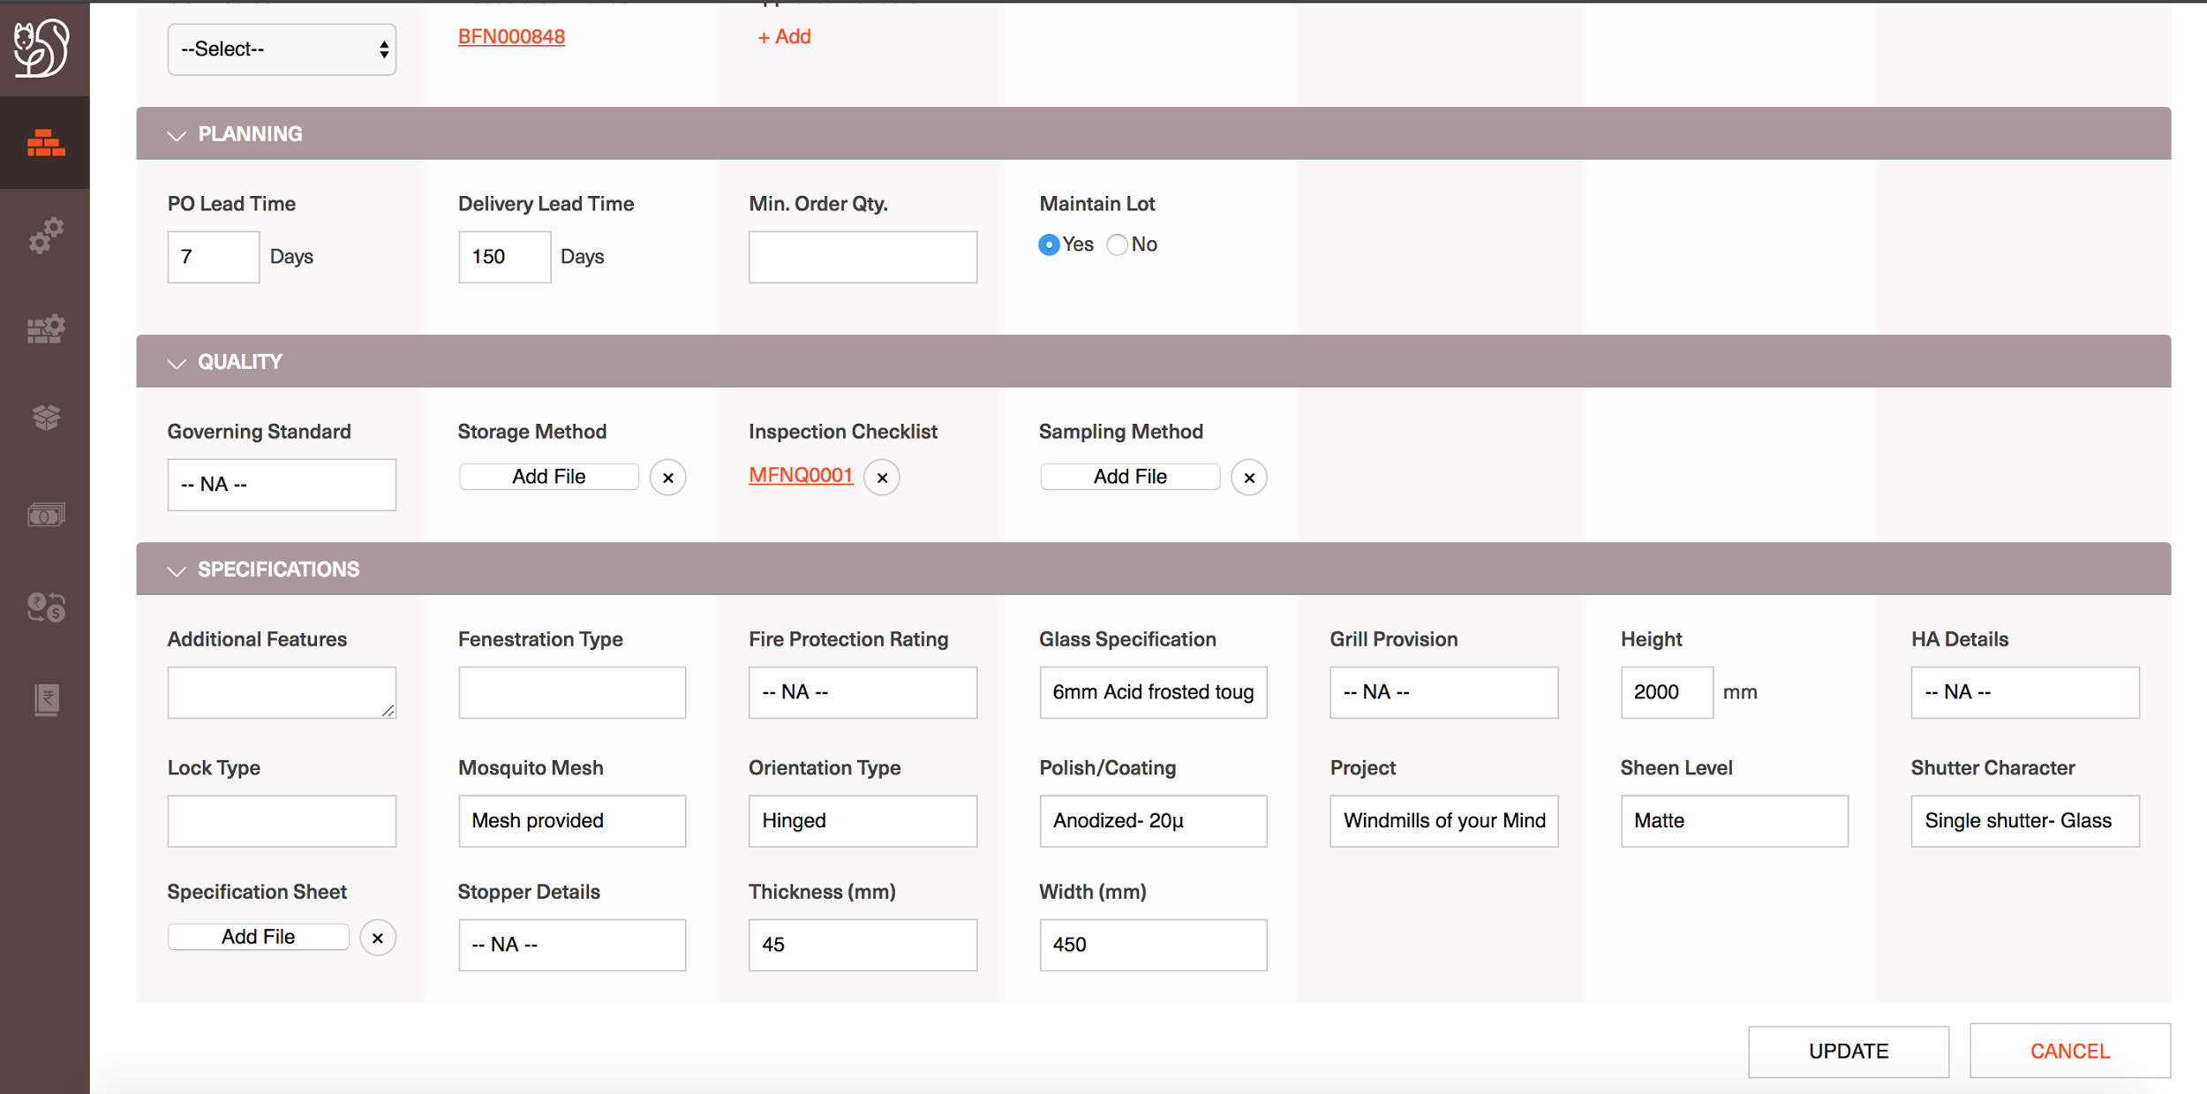
Click on ‘EDIT’ to update material details
Edit Material details and ‘UPDATE’

Slide 26
Define Asset properties for a material
Log into CL and navigate to Materials homepage or search results for material
Navigate to Material detail page for the specific material or Navigate user to a Create new material page
Define a material as an Asset:
Choose ‘Can be used as an Asset’ -> Yes
Accordingly all the Asset properties that a material can be defined with will be displayed at the end of the page under ‘Maintenance’ header
User can update the Maintenance properties as required and submit/save changes made to the material details

Slide 27
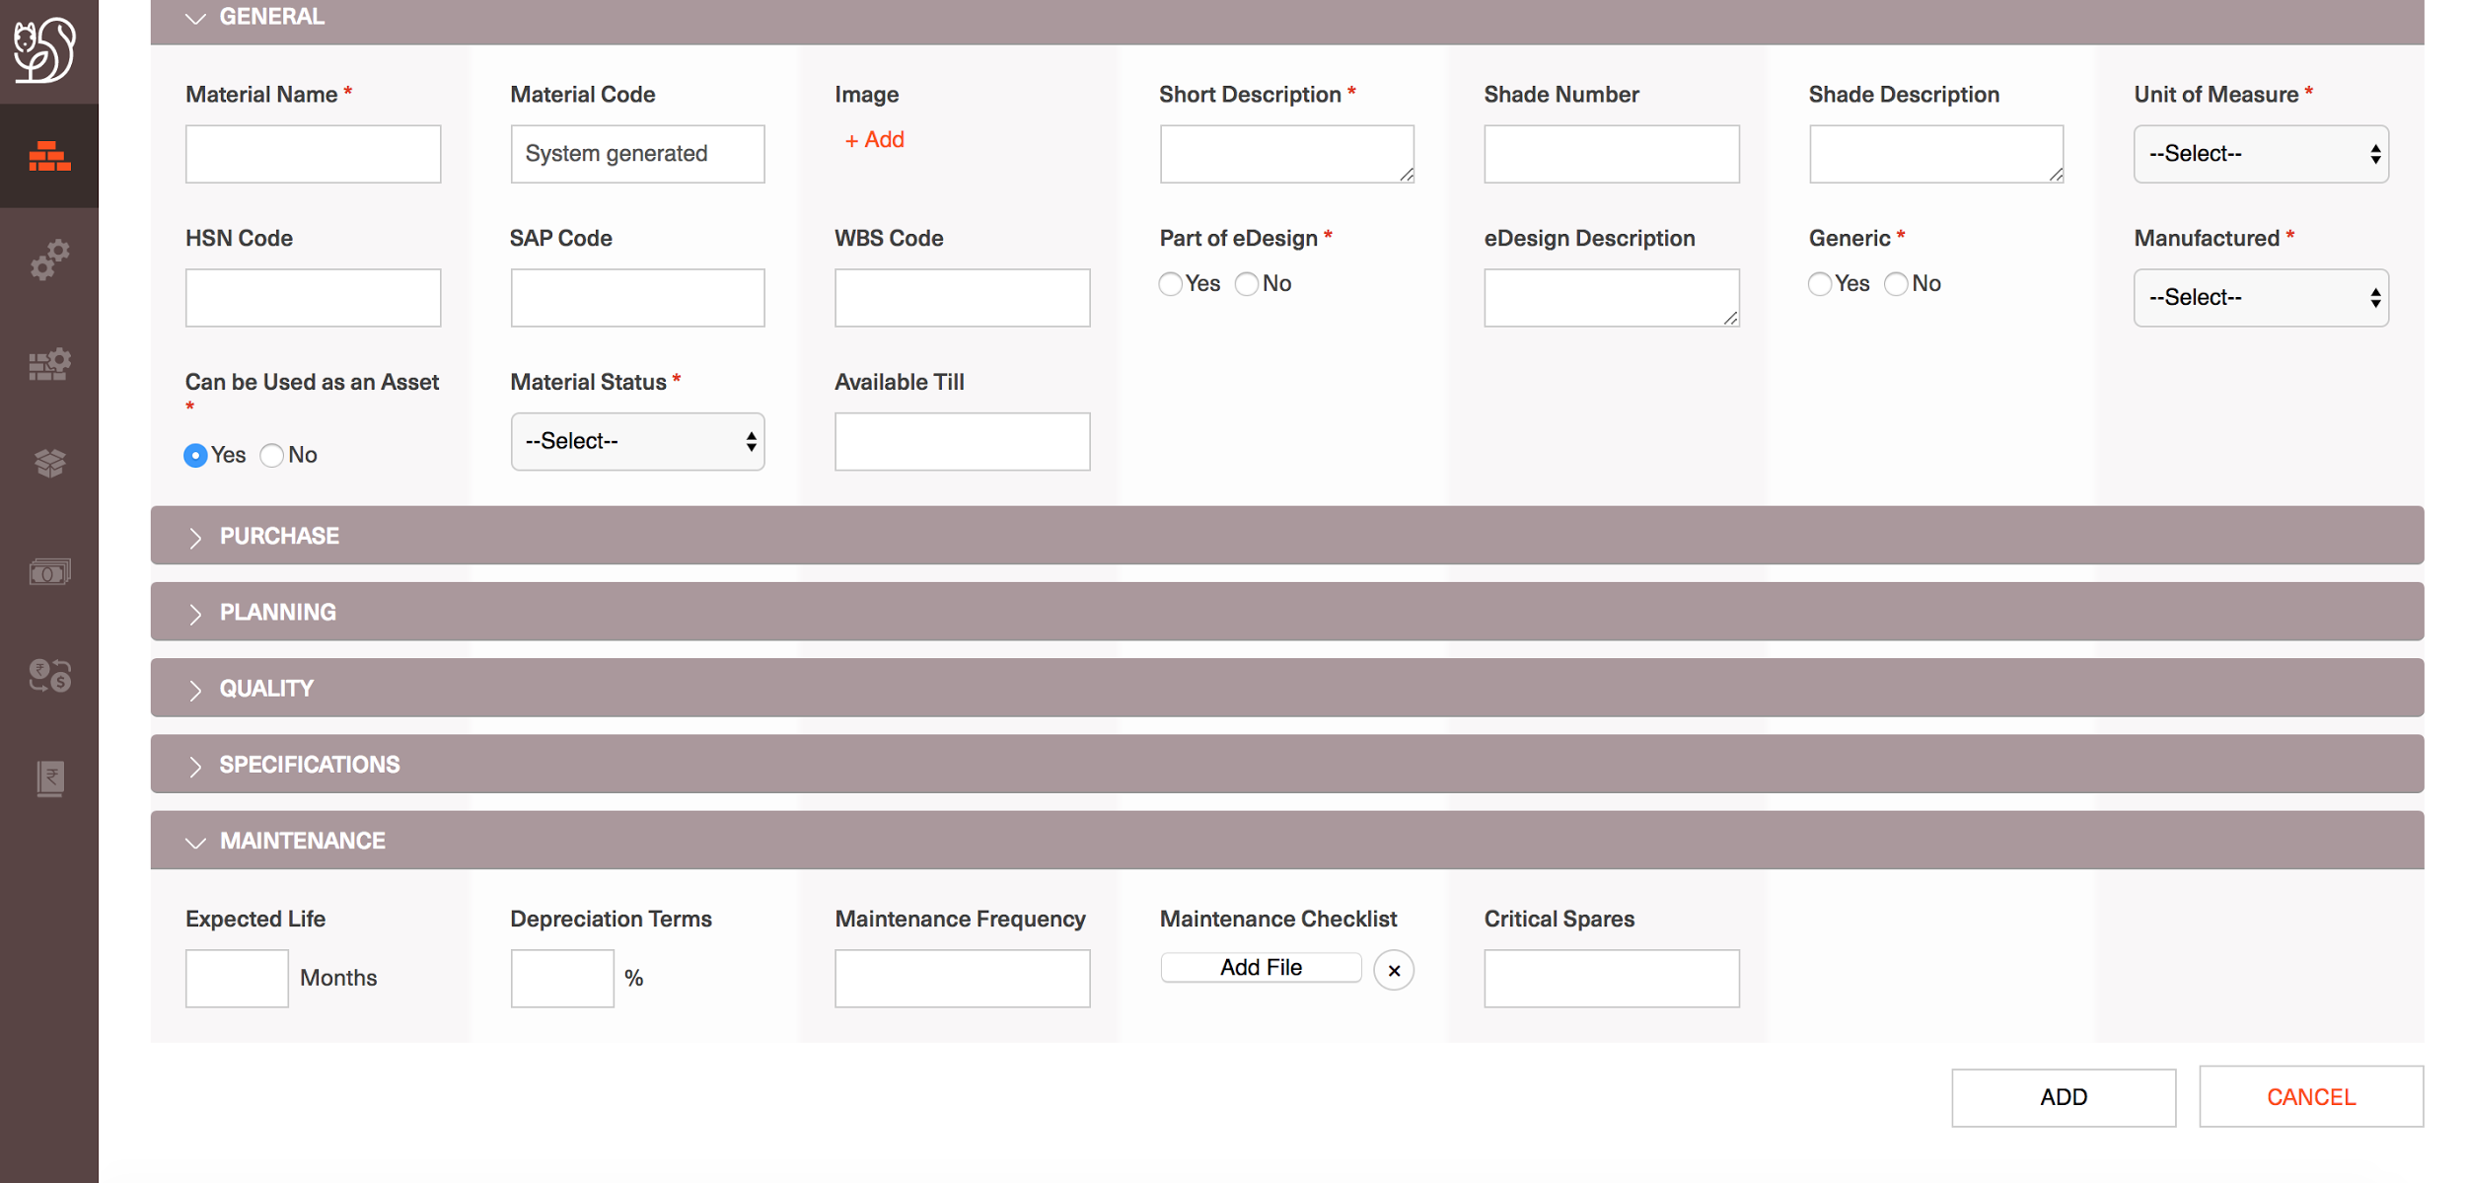
During Material Create, Choose ’Can be Used as an Asset’ as ‘Yes’’
Add Maintenance properties

Slide 28
View Brands associated with a material
Log into CL and navigate to Materials homepage or search results for material
Navigate to Material detail page for the specific material
Under the Purchase section -> ‘Associated Brands’ will capture all the Brands in which the material is available.
All the Brands are displayed as links and selecting any one of them will navigate use to the ‘Associated Brands’ page

Slide 29
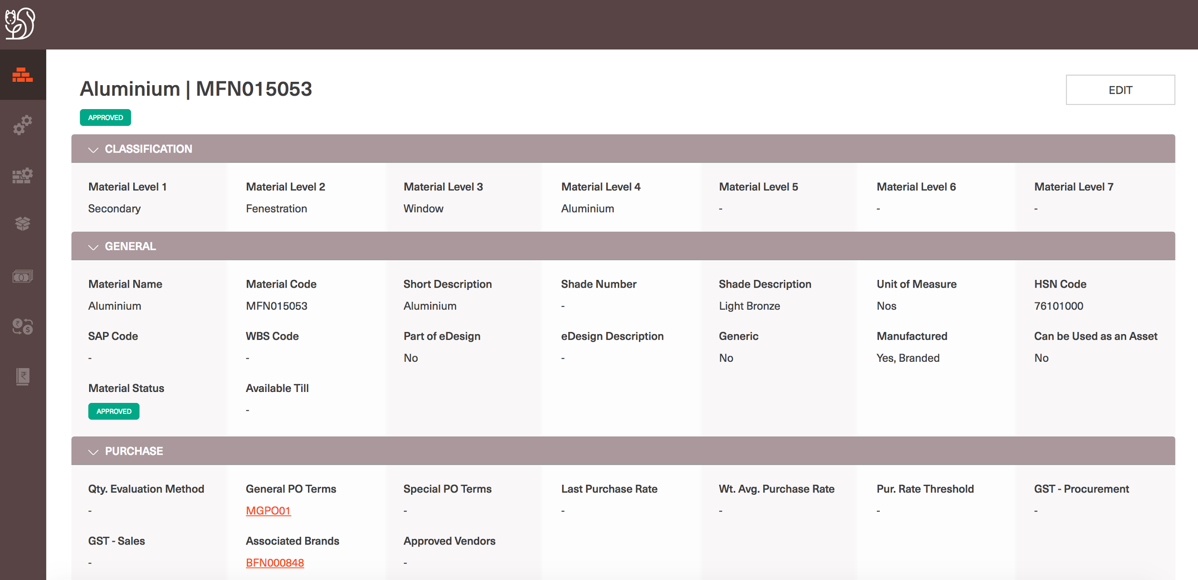
Select Associated Brand

Slide 30
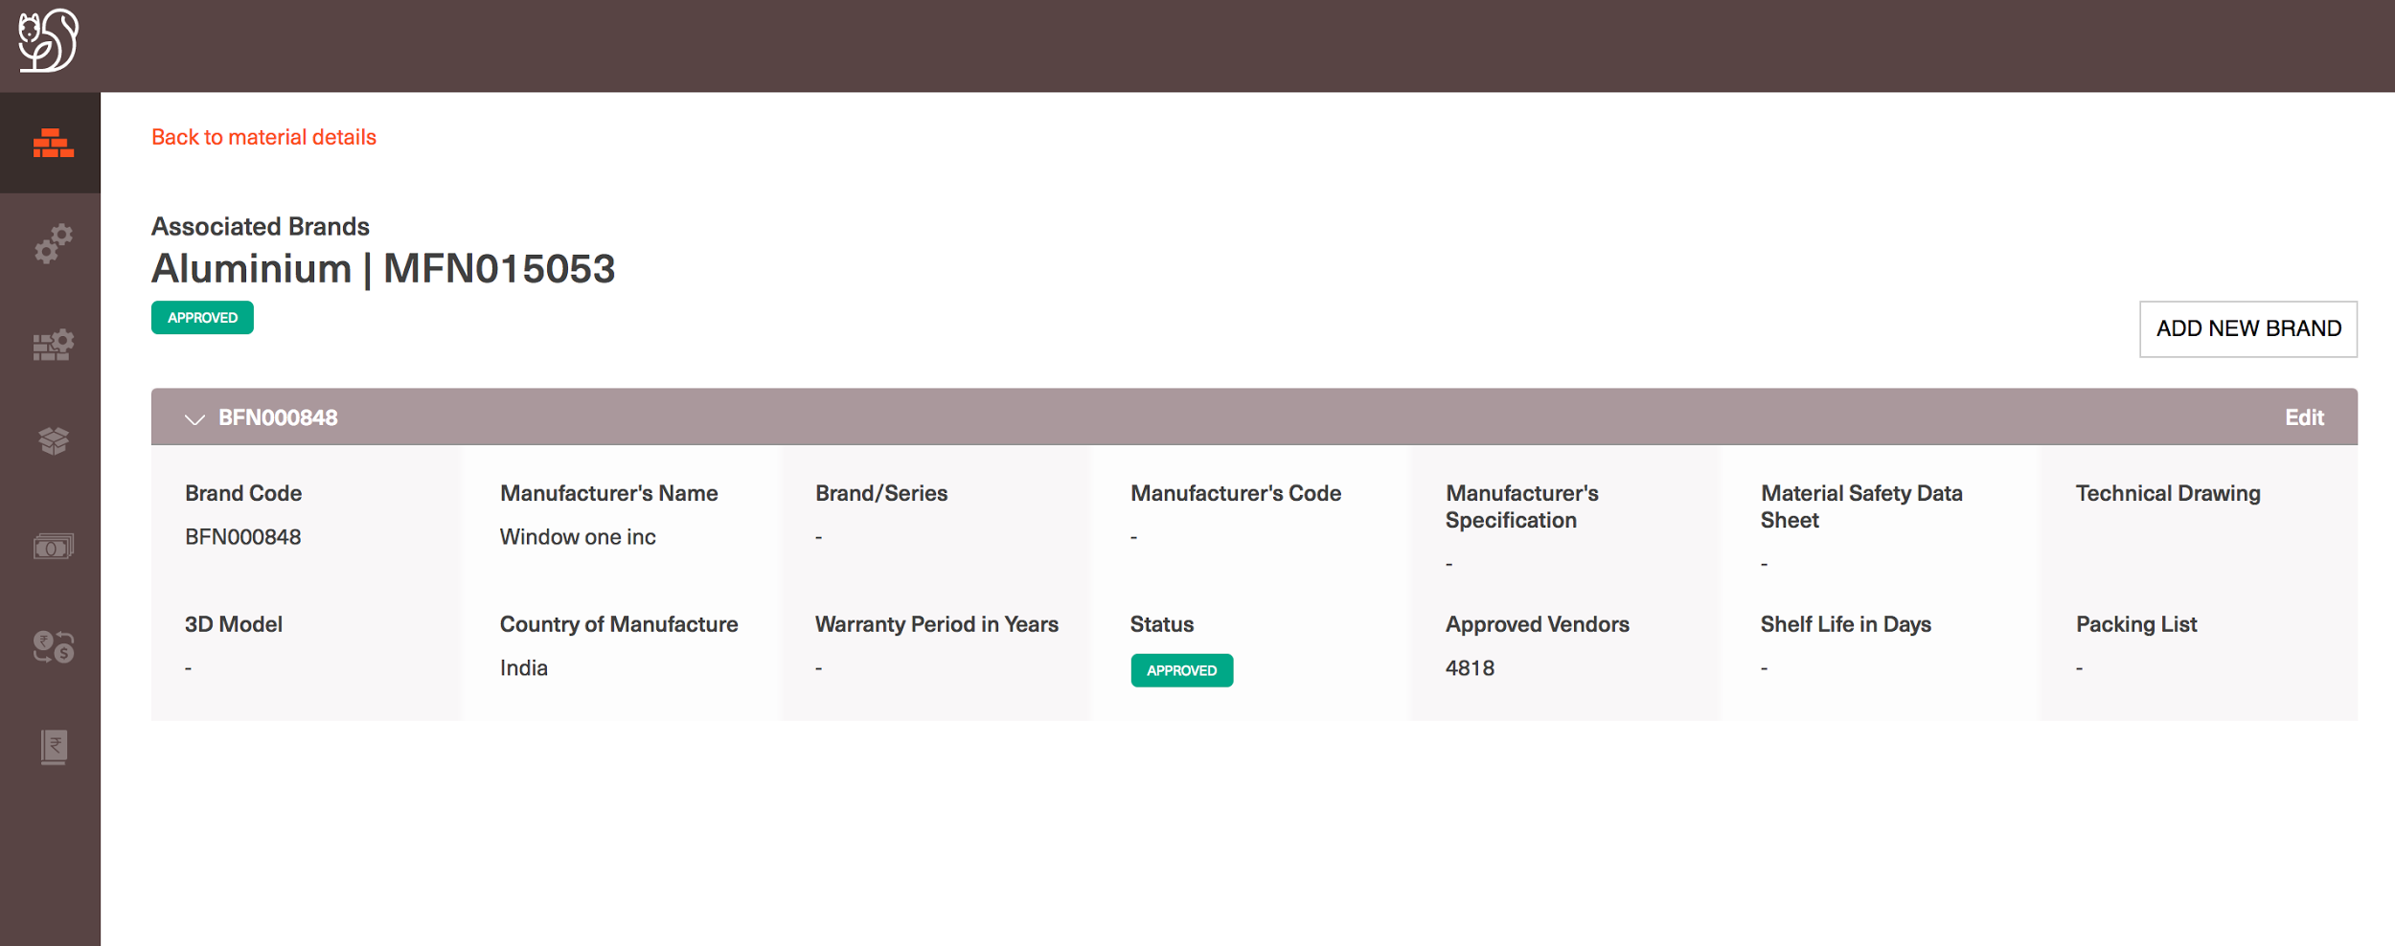
View Brand Details

Slide 31
Define a Brand for a material
Log into CL and navigate to Materials homepage or search results for material
Navigate to Material detail page for the specific material
Under the Purchase section -> ‘Associated Brands’ will capture all the Brands in which the material is available.
All the Brands are displayed as links and selecting any one of them will navigate use to the ‘Associated Brands’ page
User can add a new Brand by selecting the ‘Add New’ option at the top right corner of the page
Manufacturer’s Name and Brand Status are mandatory fields and hence system will enforce user to give valid values for both the properties to create a brand
If a Material doesn’t have any Brands user can click on ‘Add New’ under the Purchase header->Associated Brands property and will be navigated to the Creating a new Brand page

Slide 32
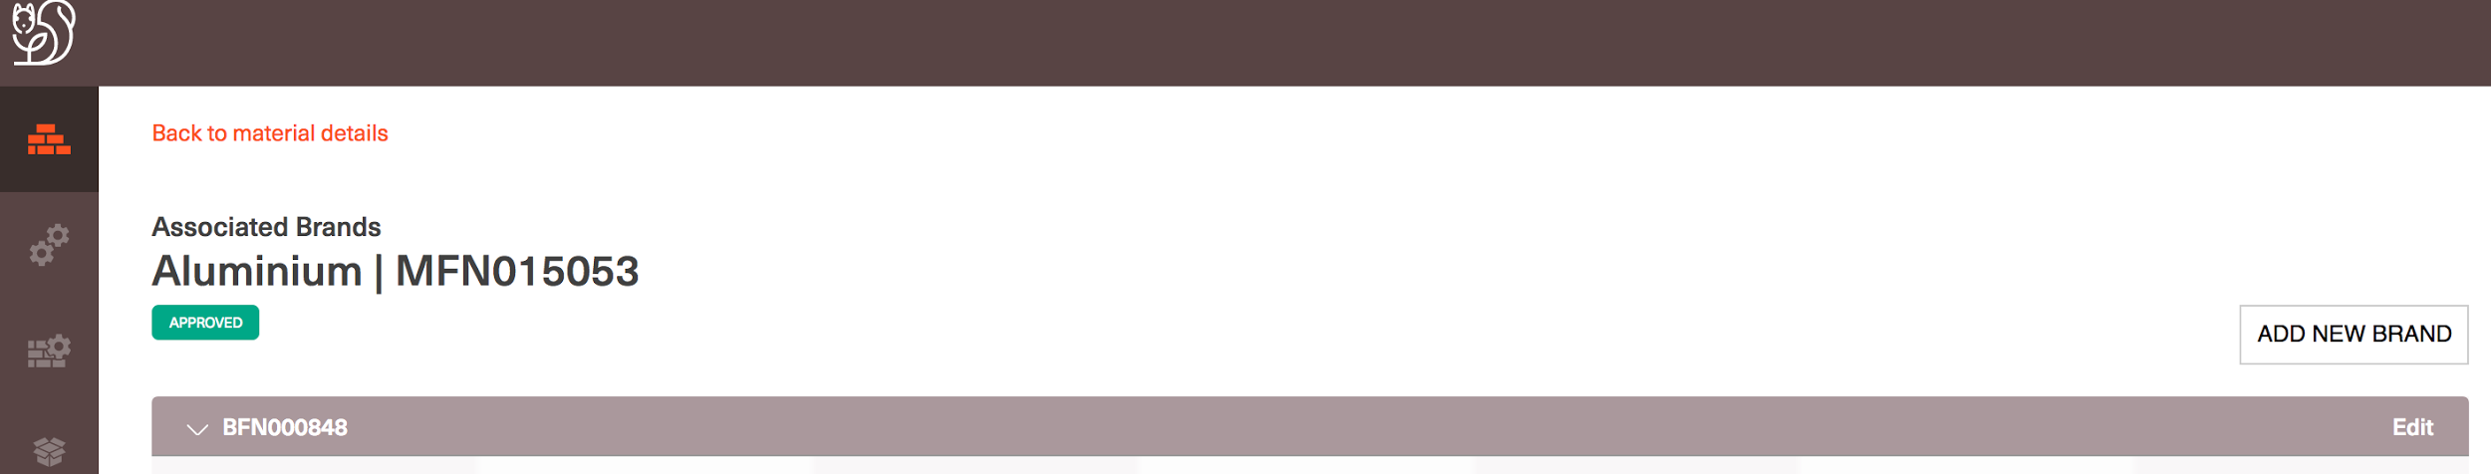
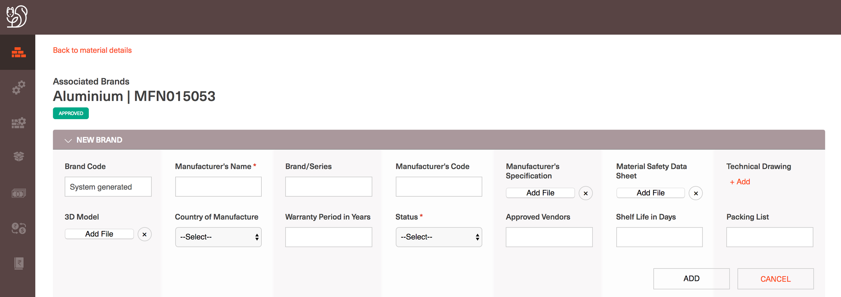
Select ‘ADD NEW BRAND’’
Enter Brand Details and ‘ADD’

Slide 33
View Rate History of a material
Log into CL and navigate to Materials homepage or search results for material
Navigate to Material detail page for a specific material
Every material rate is defined by the below factors:
Location in which it being procured for
Mode of Purchase as the additional rate coefficients like Customs, Insurance charges, etc. depend on the purchase mode
Date on which is being procured (As rate varies with time and hence is versioned with time on CL DB)
Navigate user to the Rate section at the bottom of the Material details page
Select ‘View Rate History’
System navigates user to Rate History page where all the Rate versions of the material (past, present applicable and future rate versions) are displayed
Users can sort rate versions with Location and Mode of Purchase values by selecting the respective column name

Slide 34
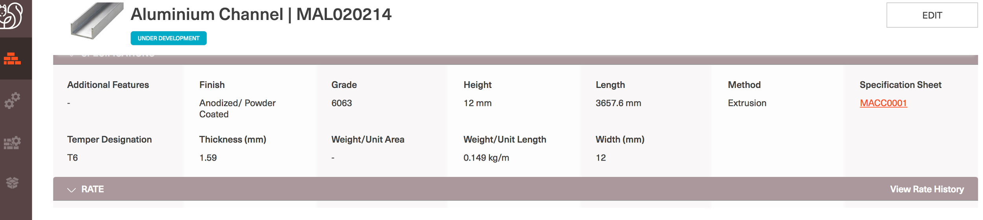
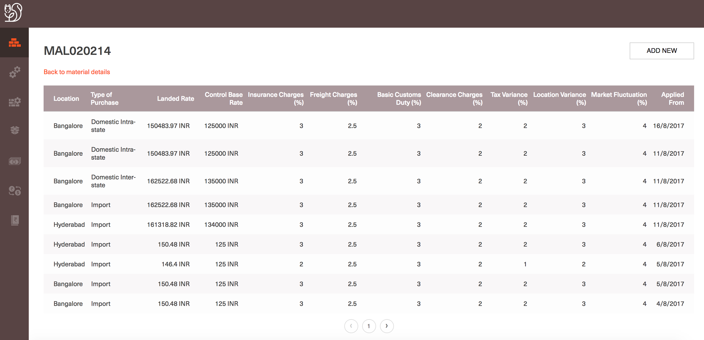
Select ‘View Rate History’
Rate History

Slide 35
Define a Rate version for a material
Log into CL and navigate to Materials homepage or search results for material
Navigate to Material detail page for a specific material
In the Rate section of Material details select ‘View Rate History’ and system navigates user to Rate History page
Click on ‘Add new’ on the Rate History page
User can add the new Rate version values for the material and submit
Mandatory fields when creating a Rate version:
Location, Mode of Purchase, Base Control Rate, Applicable from date
All the rate coefficients are defined as Percentages
On any given date only one Rate version is allowed to be defined, as the Rate version gets applicable from the defined date at 00:00Hrs IST.
When user tries to create another Rate version on any given date, system throws an error and doesn’t allow the conflict

Slide 36
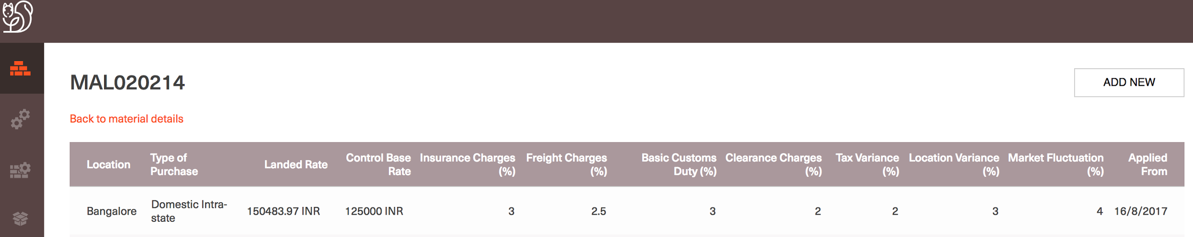
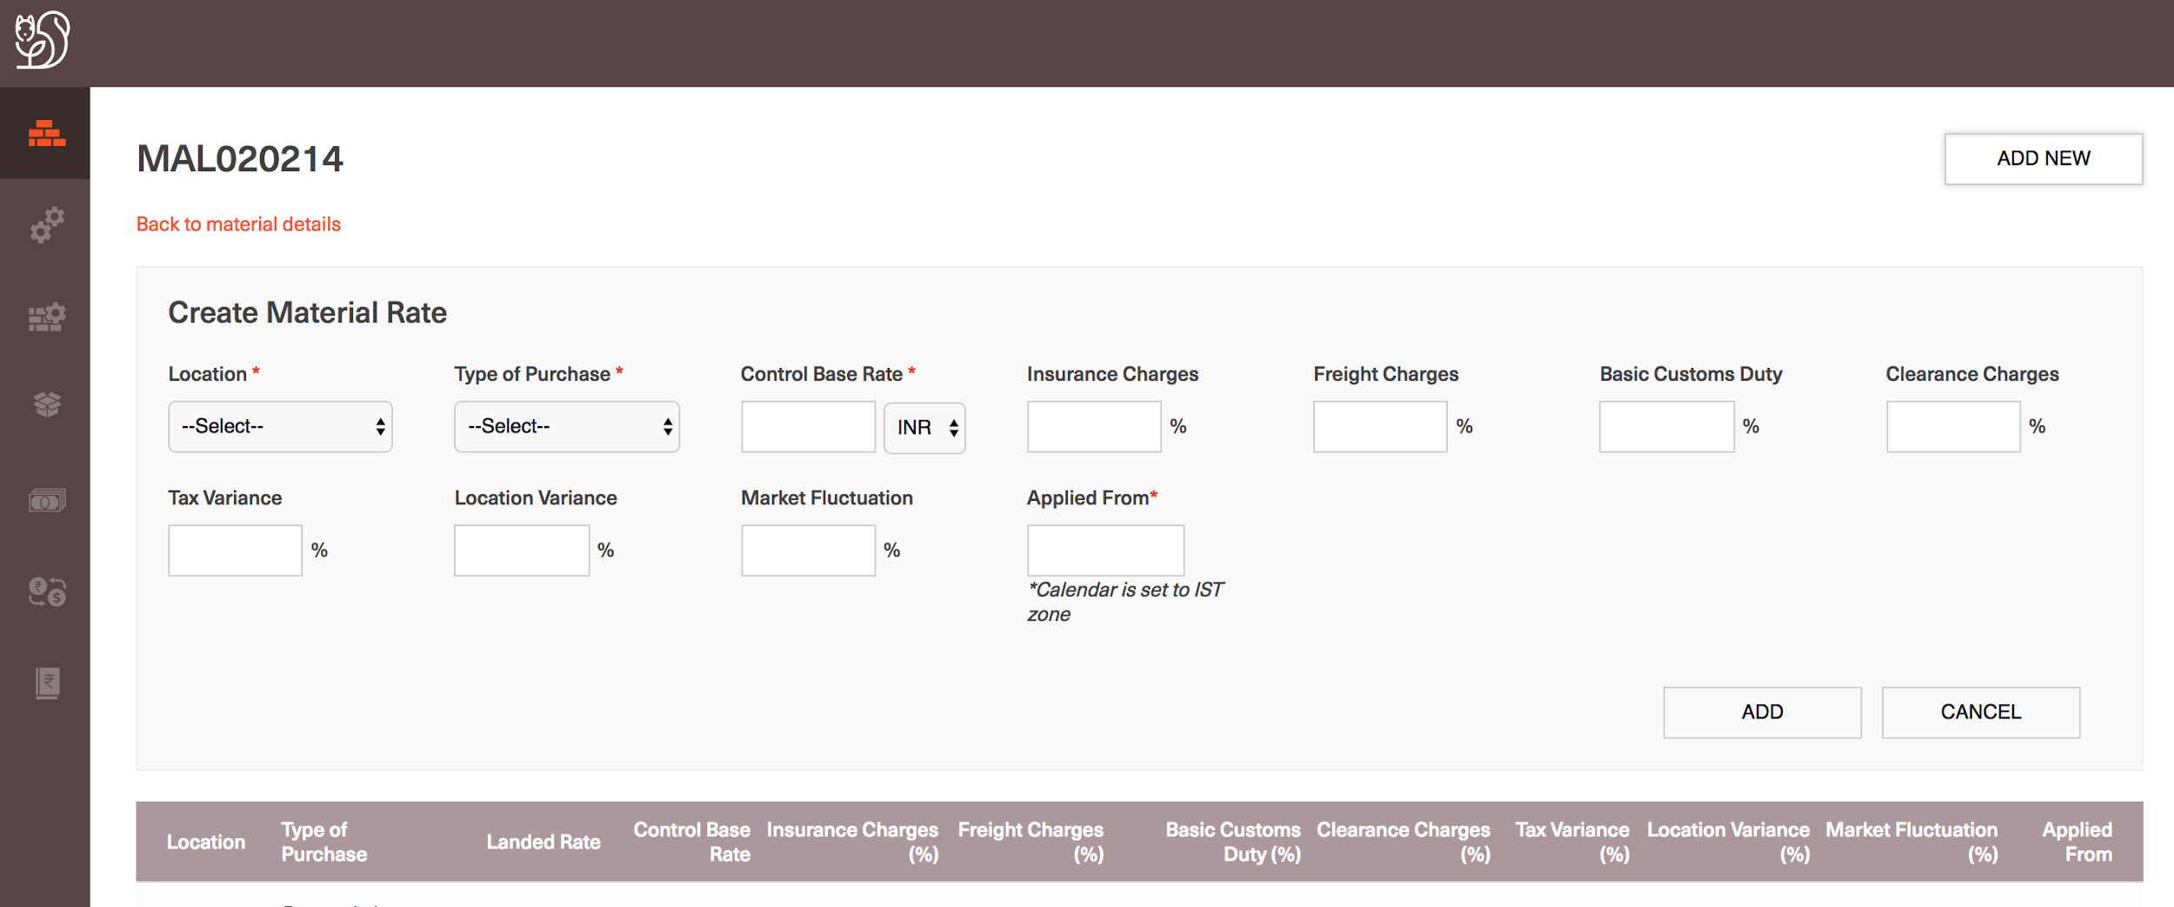
Select ‘ADD NEW’
Enter rate details and ‘ADD’

Slide 37
View current applicable Landed rate of a material
Log into CL and navigate to Materials homepage or search results for material
Navigate to Material detail page for a specific material
Navigate to the ‘Rate’ section at the end of the View Material details page
Users are shown the current rate of the material at different location and mode of purchases
Landed rate is calculated and displayed along with the Control base rate of the material

Slide 38
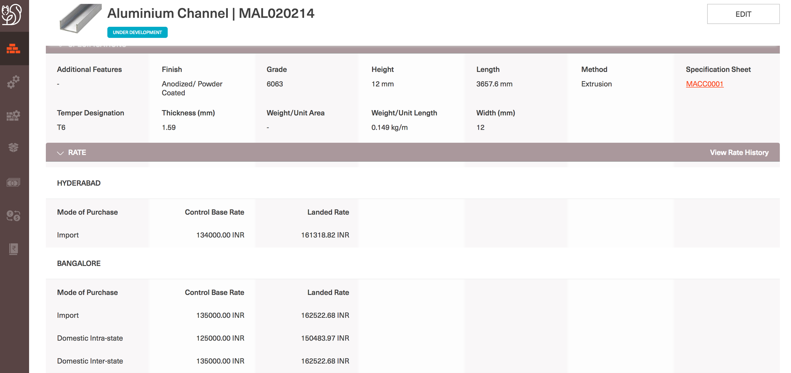
View current applicable landed rate

Slide 39
Services

Slide 40
Search for a Service
Log into CL and navigate to Services homepage
Given the Services Homepage displays all the latest added 20 Services
Enter the keyword with which search has to be performed on the top right corner of the page
As user submits the keyword system prompts different Service groups in which the given keyword is found and user needs to choose one of the group under which the search results needs to be displayed
User is navigated to the Search results screen with all the keyword matched search results in paginated fashion
User can sort or filter search results with all the Service properties
Users can also view at all the properties of the service by selecting the right property group tab

Slide 41
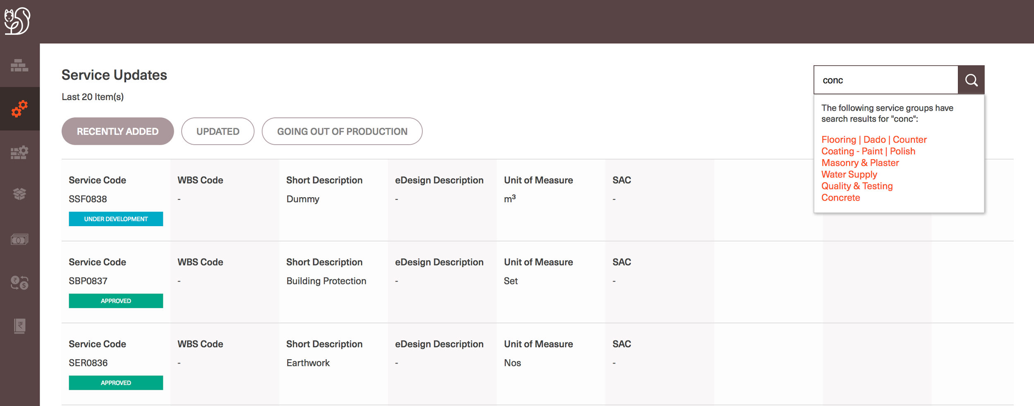

Slide 42
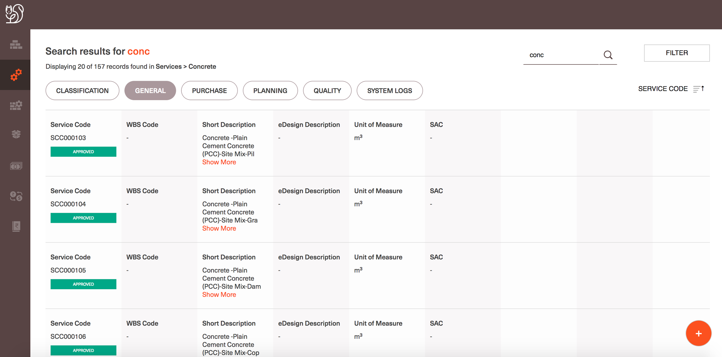

Slide 43
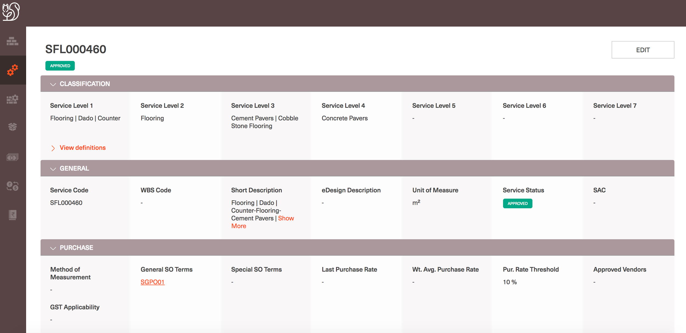
View a specific service details
Log into CL and navigate to Services homepage or search results for services
Navigate to Service detail page for a specific material
Allow users to view all the service properties in the respective group of services

Slide 44
Create a new Service
Log into CL and navigate to Services homepage
Select on the ‘+’ button at the bottom right corner of the page
Users are navigated to the Create a new Service page
User can enter all the material details in the given page and can submit
The following properties are defined as Mandatory fields for a service to be created:
Service Short Description
Service Unit of Measure
Service Status
All the Classification values that are selected by user have the respective Definitions associated with them setup in the system ahead of time as Master data values
As user creates the Service all the respective definitions are associated with the service and are displayed on the View Service details page
On Submitting the service details, user is navigated to the View Service details page
User can Upload of Link and existing file for the service properties which can hold a file or a checklist
On the Service details page, users can select ‘Edit’ and update services details as needed.

Slide 45
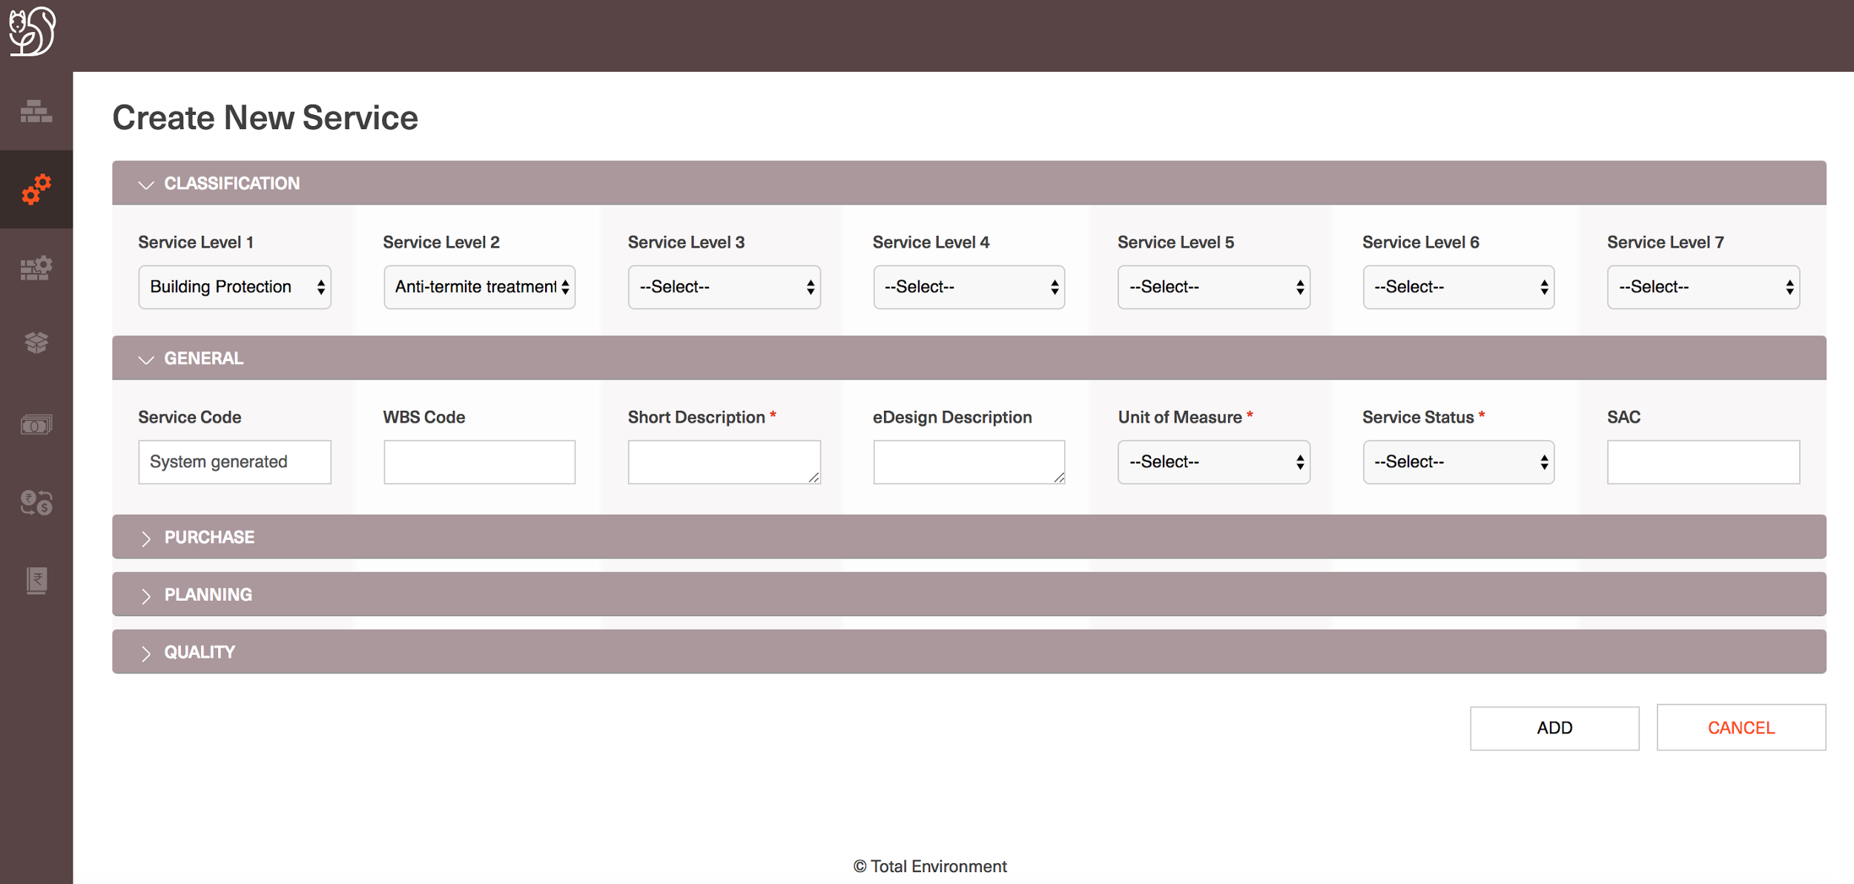

Slide 46
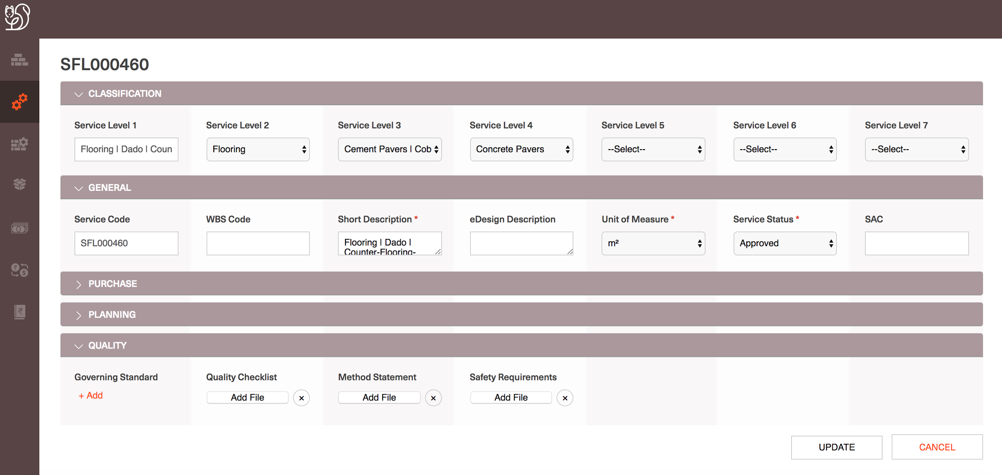

Slide 47
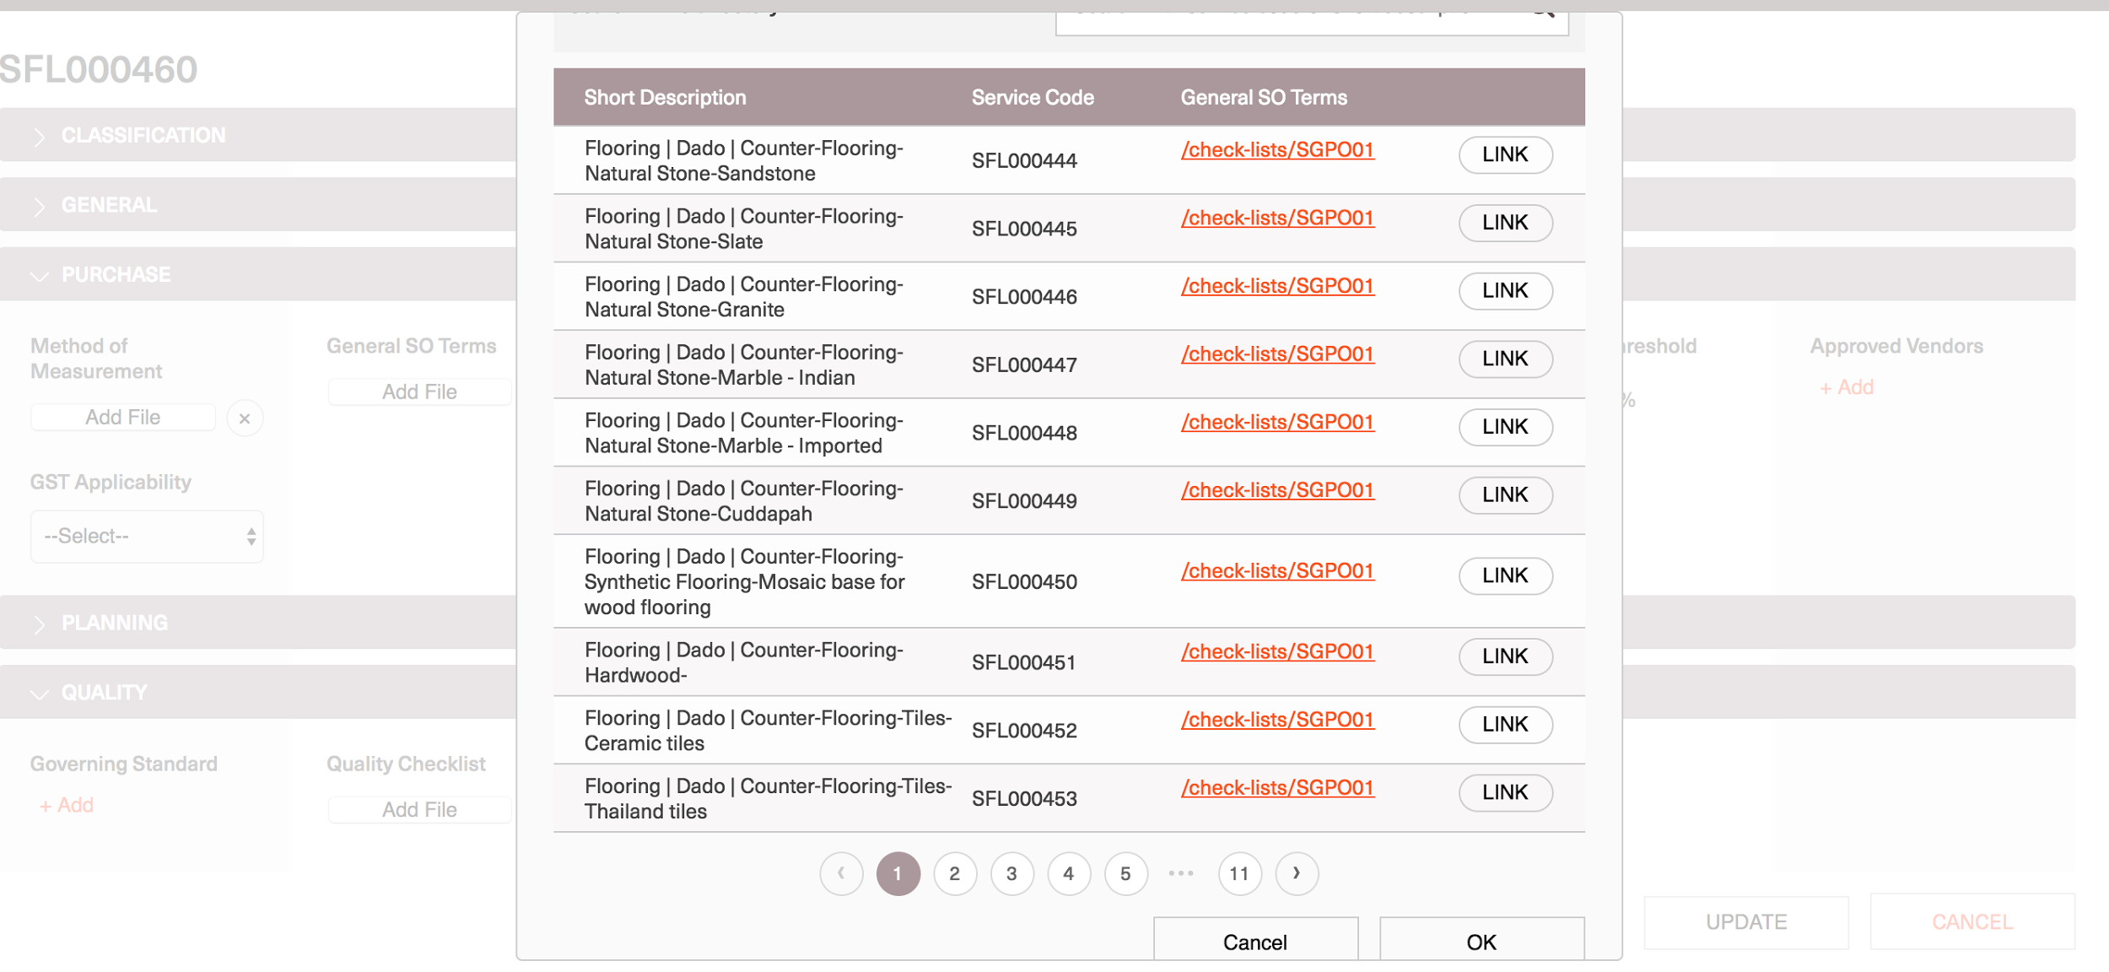

Slide 48
Service Rate
Log into CL and navigate to Services homepage
Navigate to a Service details page
At the end of the Service details similar to material details page, Service current applicable rates are displayed in the ‘Rate’ section
Service Rate similar to that of a material is dependent on the Location, Mode of Purchase and Versioned with time.
Service rate at different location and different mode of purchases applicable as of the current date are displayed in the Rate section
User can navigate Rate history page by selection the ‘View Rate History’ option
On the Rate History page, all the rate versions of the Service are displayed (Past, Present and Future rate versions setup for the service)
User can ’Add a new Service rate version’ by selecting ‘Add new’ on the page
Service Rate version can be created by submitting all the details
Mandatory fields: Location, Mode of Purchase, Base Control rate, Applicable from
Users can only create Future rate versions
On any specified date only one rate version for a Service is allowed.

Slide 49
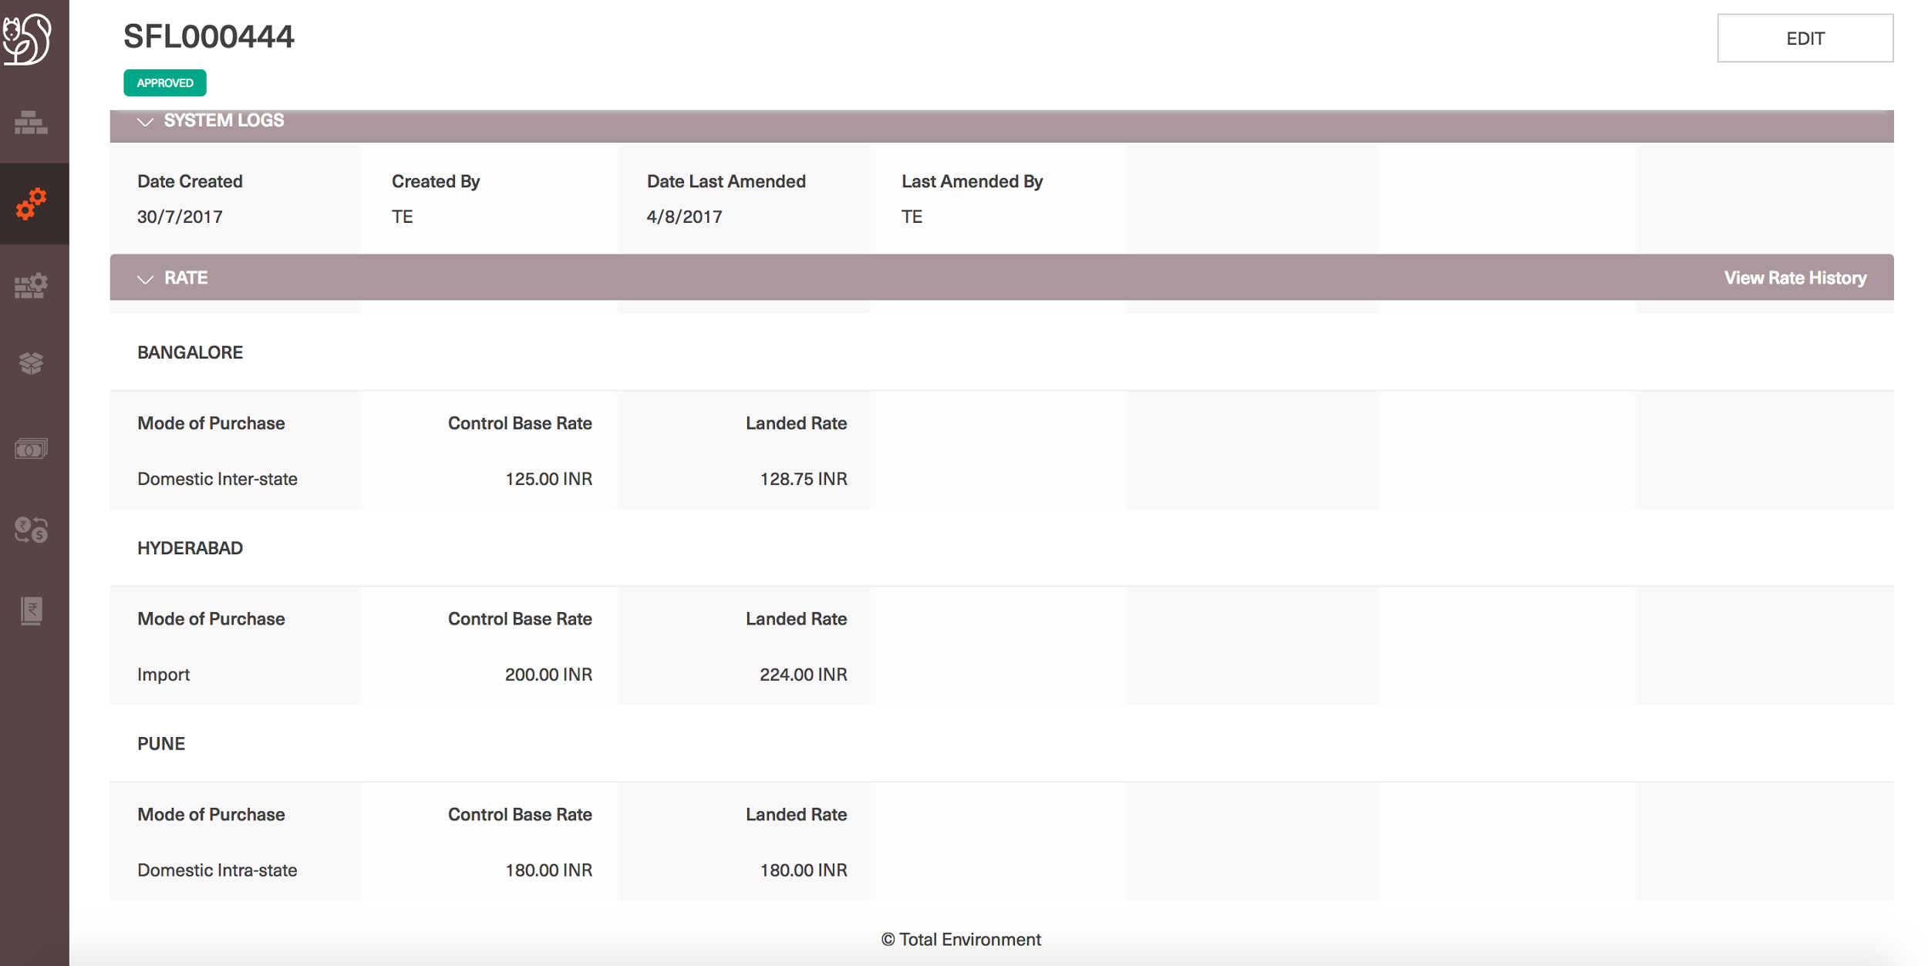

Slide 50
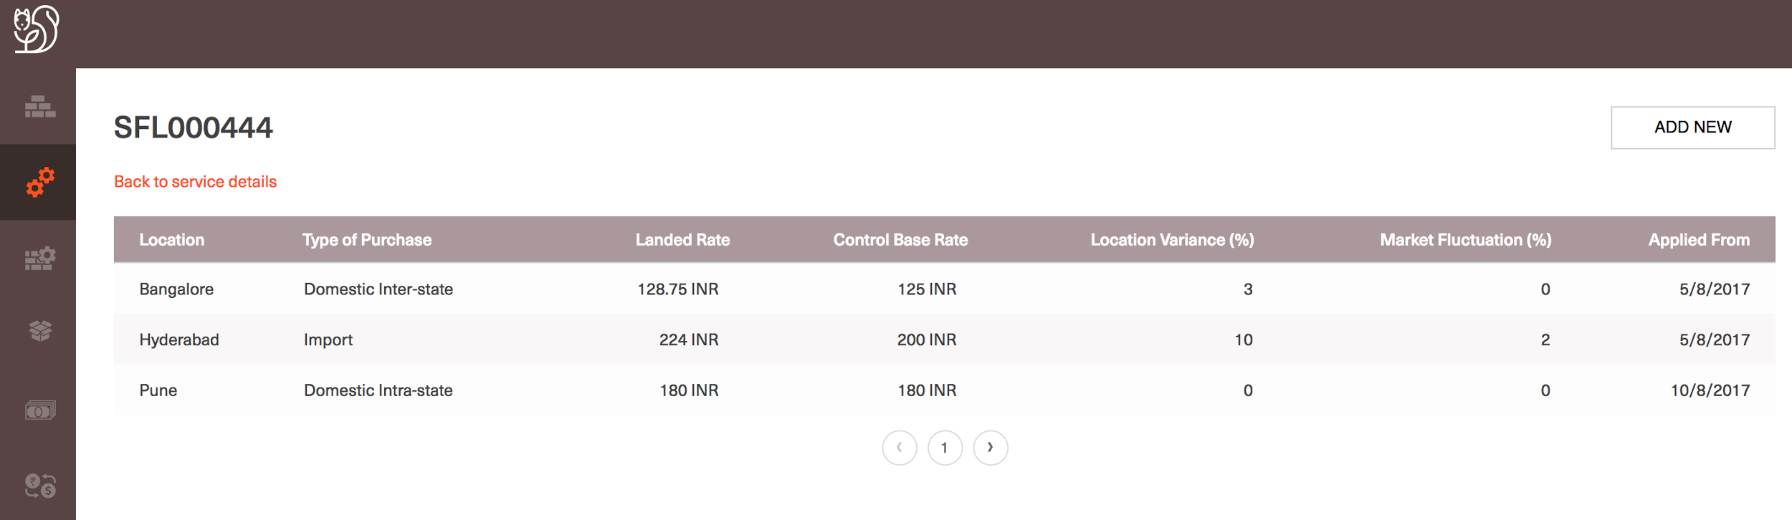

Slide 51
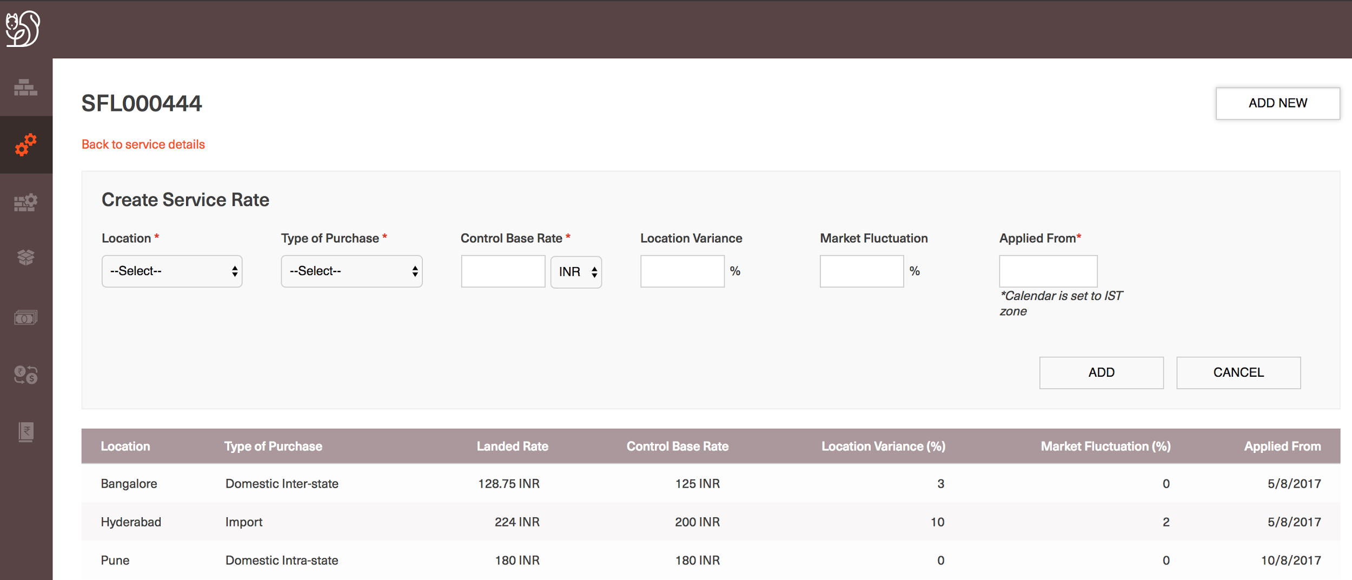

Slide 52
SFG (Semi-Finished Good)

Slide 53
Search for a SFG
Log into CL and navigate to SFG homepage
Given the SFG Homepage displays all the latest added 20 Services
Enter the keyword with which search has to be performed on the top right corner of the page
User is navigated to the Search results screen with all the keyword matched search results in paginated fashion
User can sort or filter search results with all the SFG properties
Users can also view at all the properties of the SFG by selecting the right property group tab

Slide 54
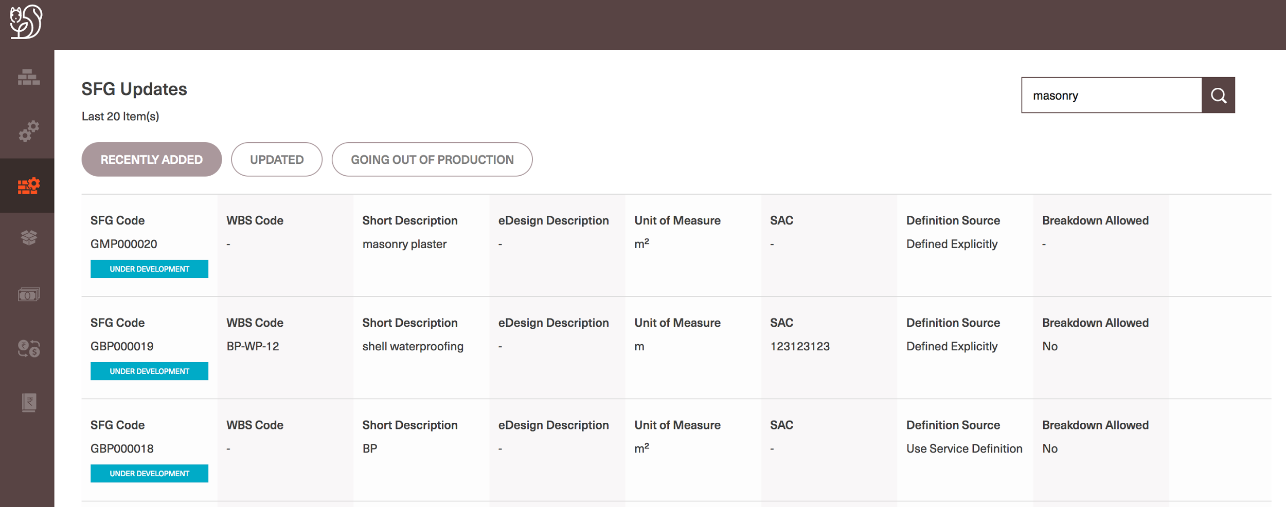

Slide 55
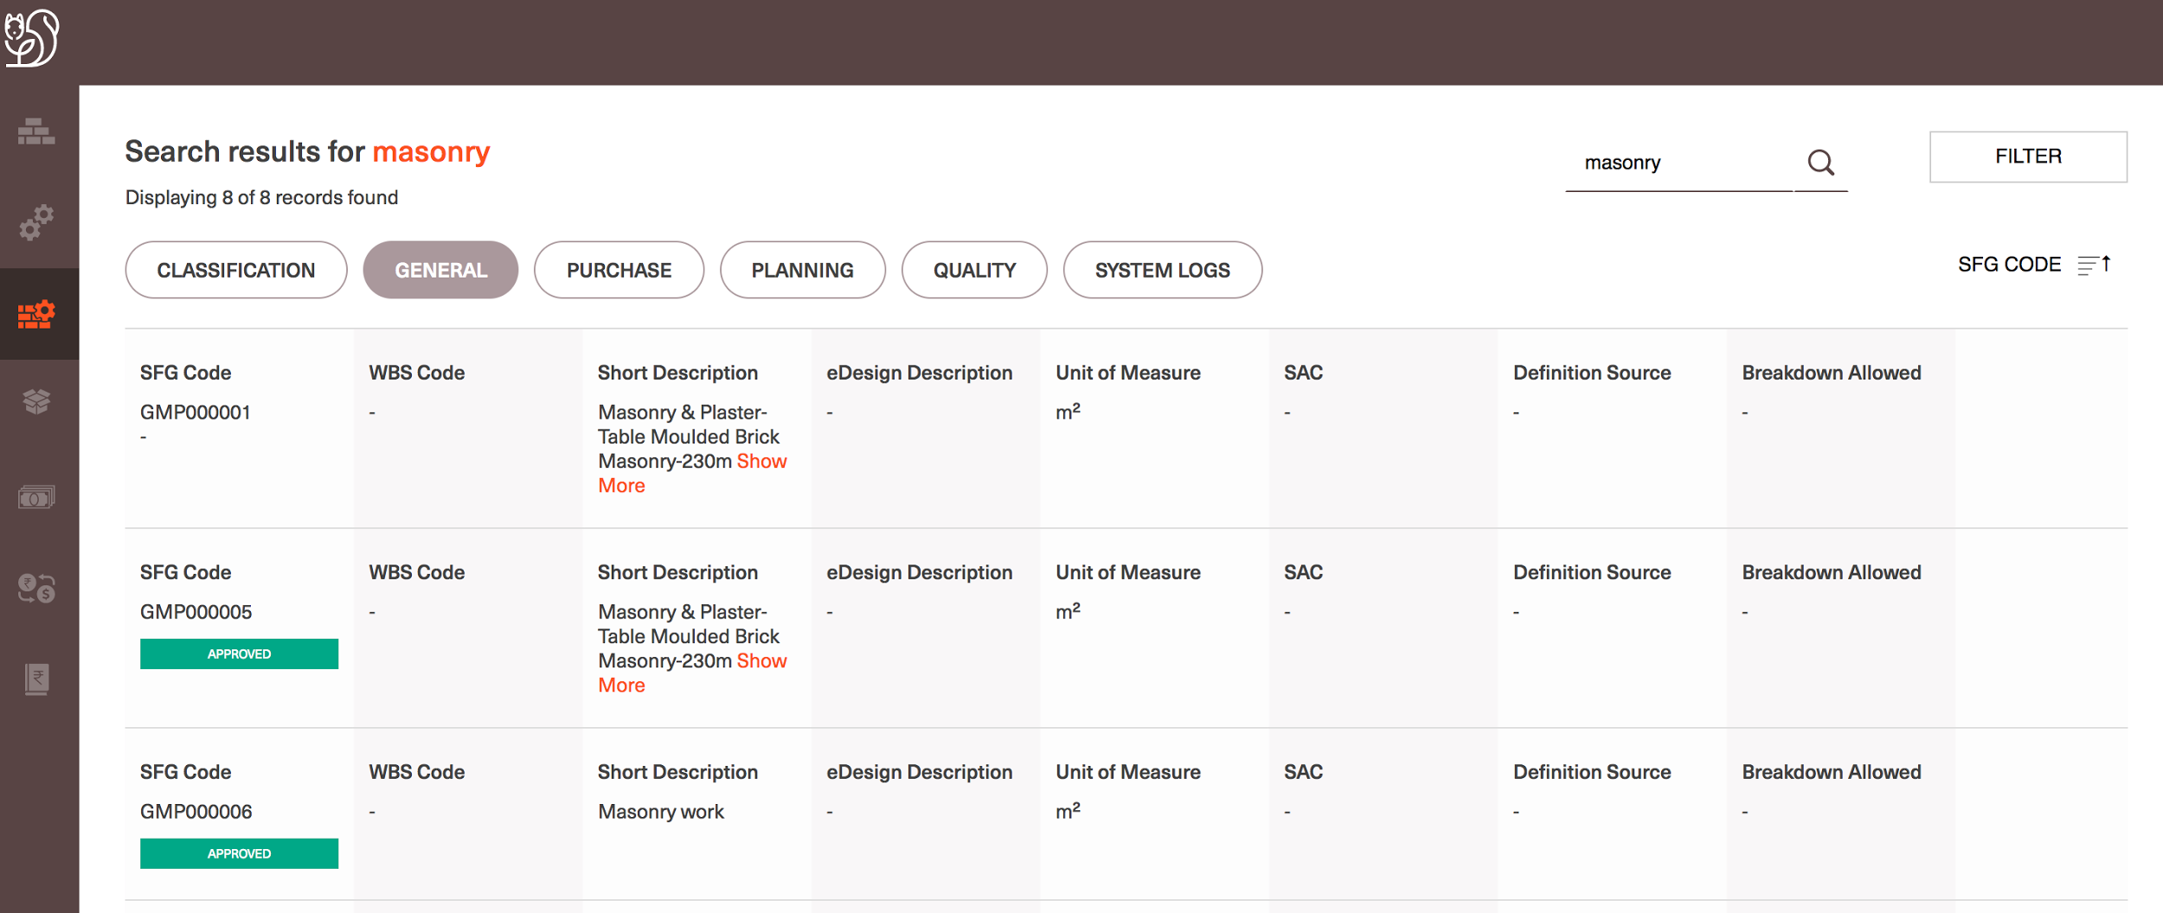

Slide 56
Create a new SFG
Log into CL and navigate to SFG homepage
Select on the ‘+’ button at the bottom right corner of the page
Given that an SFG is a combination of one or more Material, Service and Asset; user should first be able to defined all components that form the specific SFG they are trying to create
Allow users to search for the required individual components by selecting the following properties:
Select the ‘Resource type’ = Material/Service/Asset needed
All the 7 level of classification properties are displayed for the respective resource group
User can filter out the required group of components using the classification level values and accordingly all the search results are displayed
For Materials/Assets: General and Specification properties are displayed. For Services: General properties are displayed
User can select more than one component to add to the SFG
User can change the filters and make further selections and system shall recall all the selections and add the same to the SFG
User needs to select a minimum of 2 components to create an SFG
For every component associated with SFG, coefficient should be defined.
All the components coefficient form the entire SFG. Hence the composition of 1 unit of SFG includes all the components in the specified compositions
As user defines to ‘Add’ the components selected, rest all the SFG properties are displayed for the user to define.
User can choose to add more components to the SFG or can continue defining further details about the SFG
Mandatory fields for creating an SFG: Short description, SFG Unit of Measure, Status

Slide 57
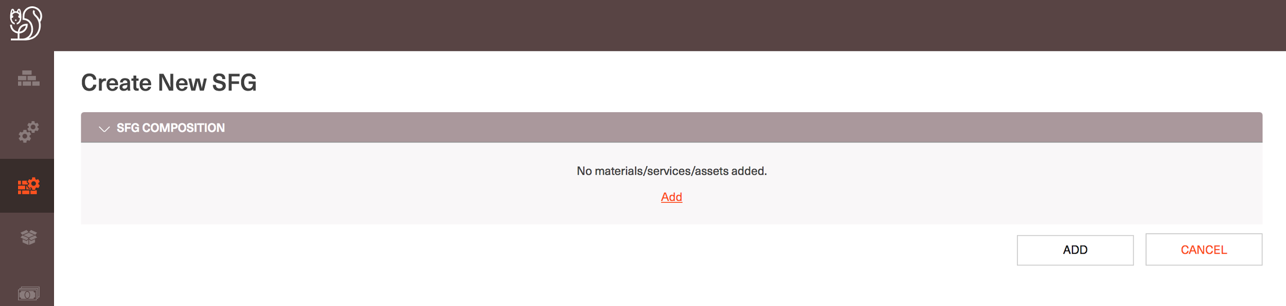

Slide 58
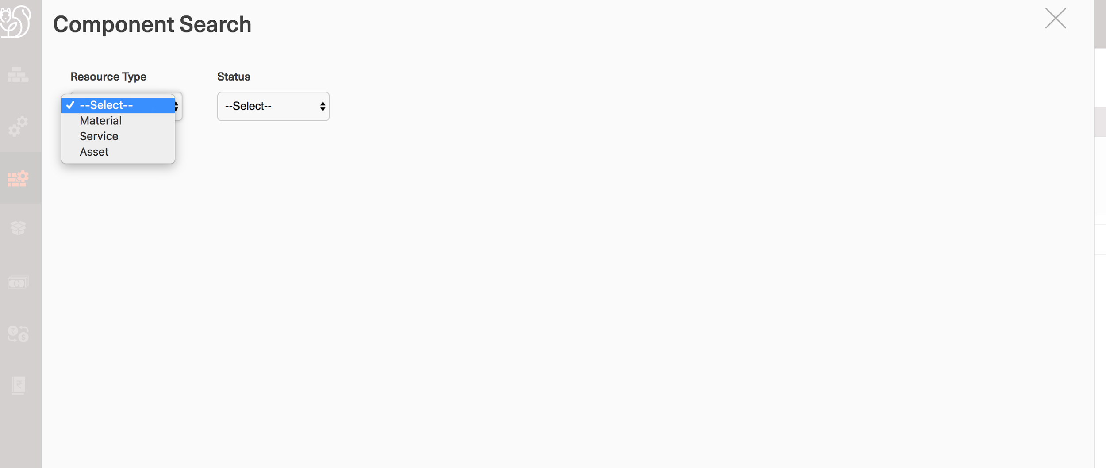

Slide 59
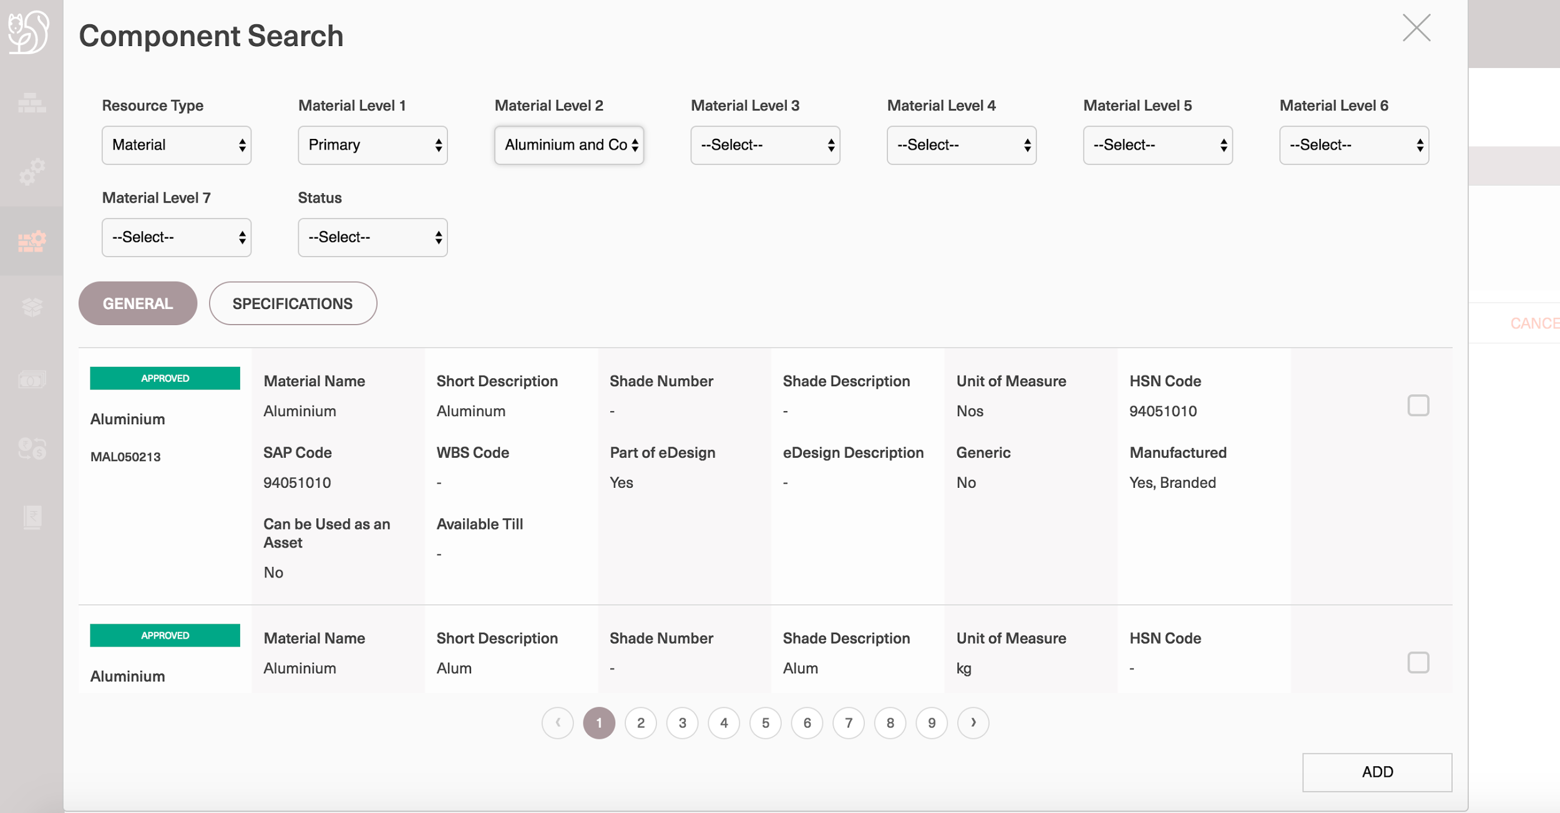

Slide 60
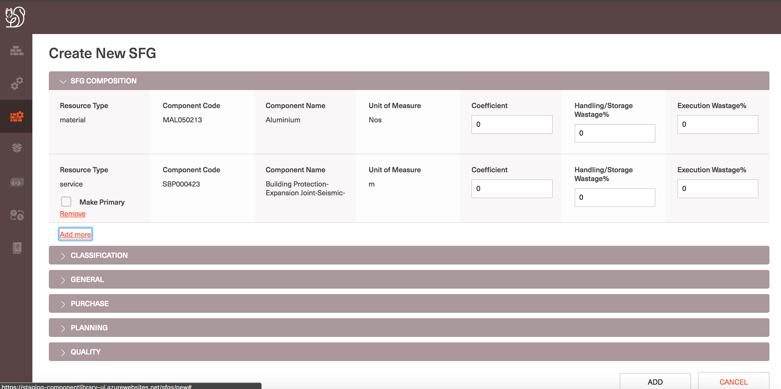

Slide 61
View SFG Details and Cost of an SFG
Log into CL and navigate to SFG homepage
Navigate to a SFG details page
SFG Cost = Sum of Cost of all the components that are associated with an SFG
Cost of each component = Average Landed Rate of the component * Coefficient of the component for the SFG
Average Landed Rate of a component = Average of landed rate in all the mode of purchases in a given location and on a specified date.
To View cost of an SFG, user should navigate to the required SFG details page
In the composition section on the right corner of the section, define the Location and Date for which the Cost of the SFG is required
Accordingly the Cost of the SFG is calculated and displayed along with the breakup of the Cost for each component

Slide 62
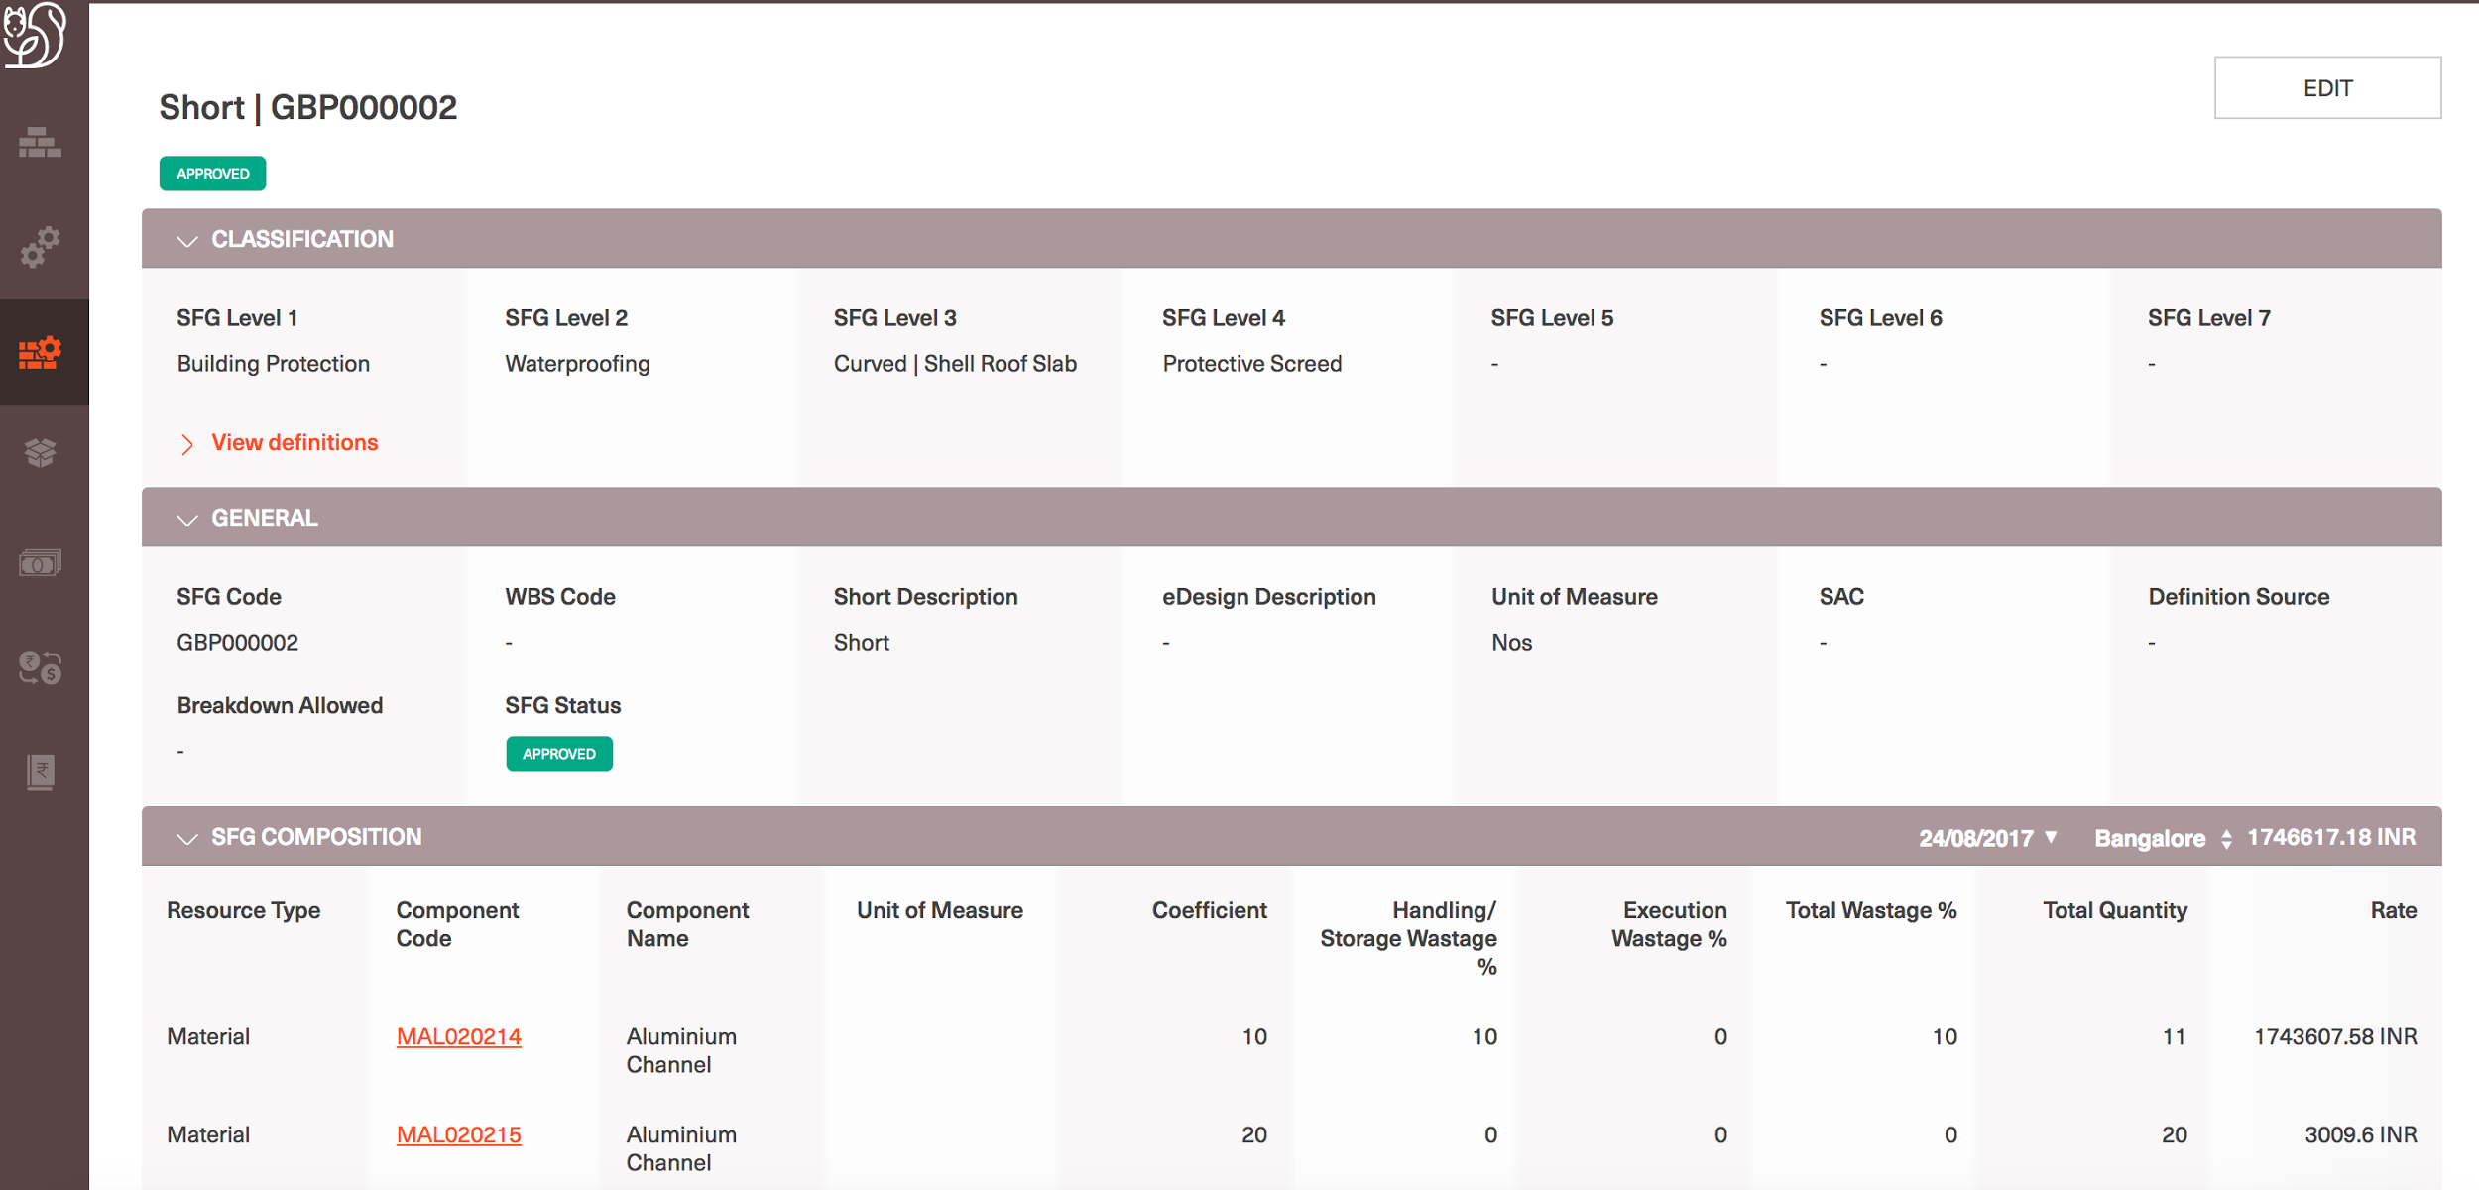

Slide 63
Update SFG Details
Log into CL and navigate to SFG homepage
Navigate to a SFG details page
Select on the ‘Edit’ button on the top right corner of the page
All the SFG properties are editable
Users can update the SFG properties and submit
Users cannot add or remove components from SFG details once created
Users can still change the coefficient values of the components associated with an SFG

Slide 64
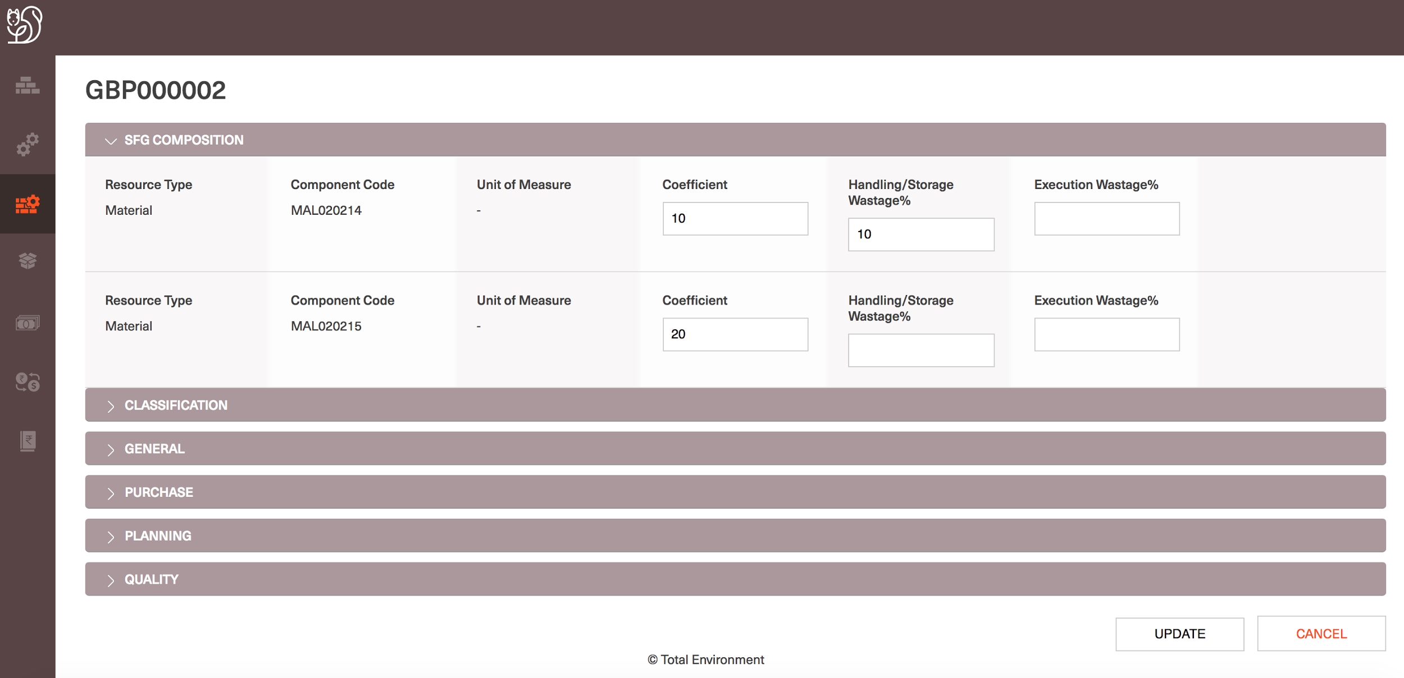

Slide 65
Packages

Slide 66
Search for a Package
Log into CL and navigate to the Packages homepage
Given the Packages Homepage displays all the latest added 20 Services
Enter the keyword with which search has to be performed on the top right corner of the page
User is navigated to the Search results screen with all the keyword matched search results in paginated fashion
User can sort or filter search results with all the Package properties
Users can also view at all the properties of the Package by selecting the right property group tab

Slide 67
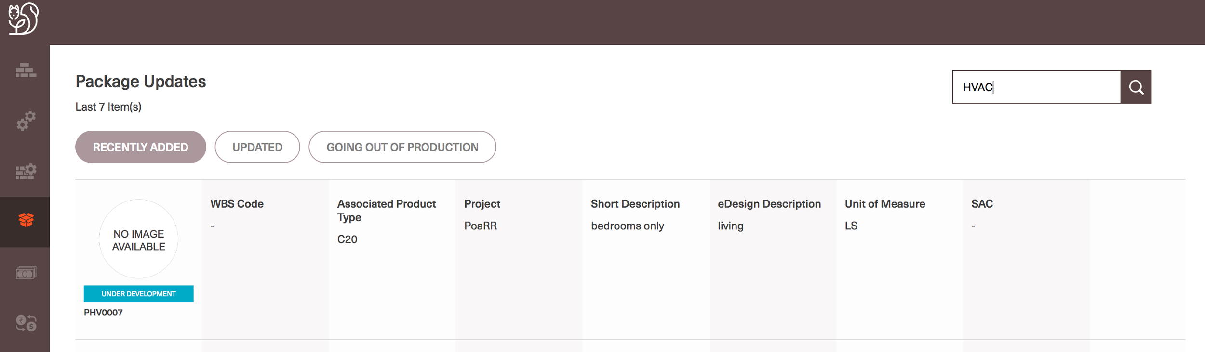

Slide 68
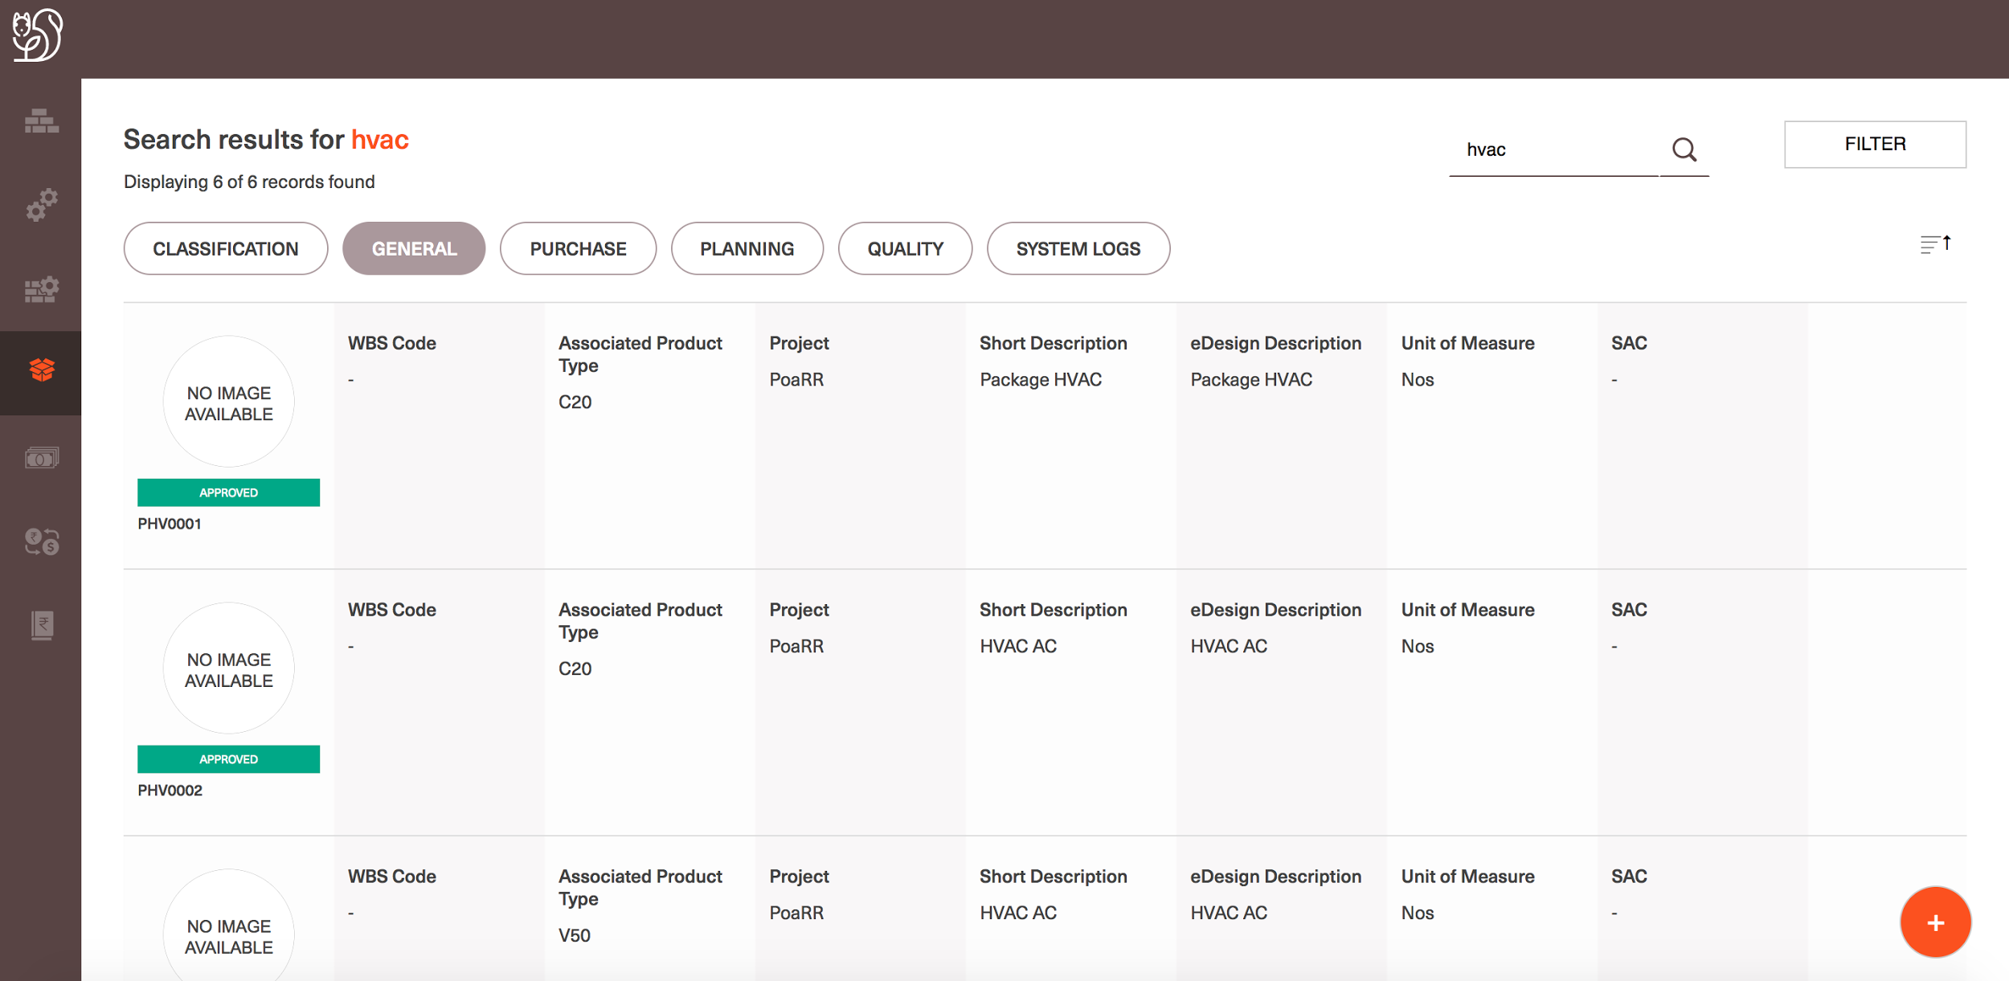

Slide 69
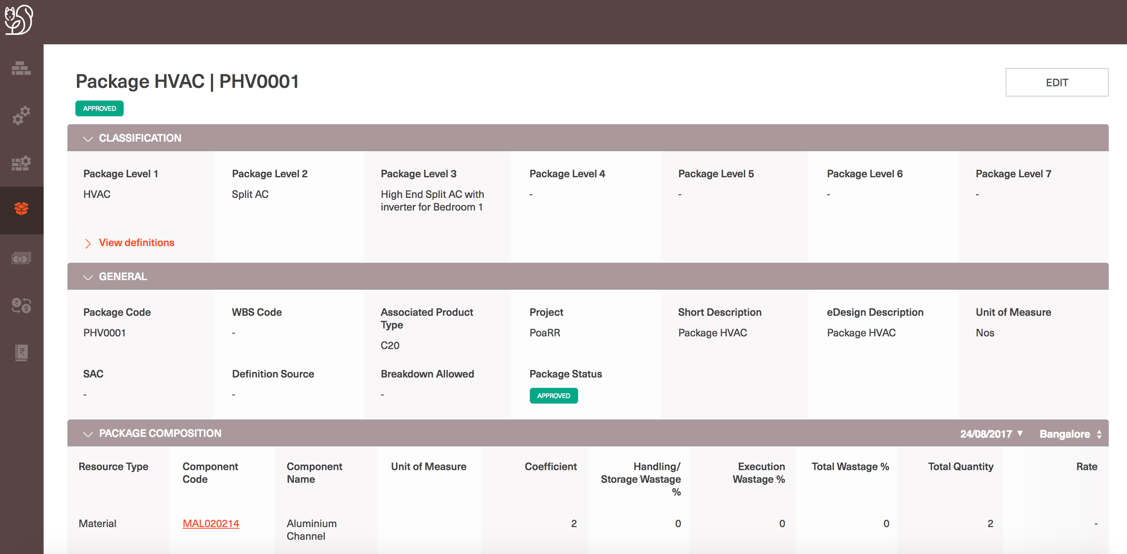

Slide 70
Create a new Package
Log into CL and navigate to the Packages homepage
Select on the ‘+’ button at the bottom right corner of the page
Given that a Package is a combination of one or more SFG, Material, Service and Asset; user should first be able to defined all components that form the specific Package they are trying to create
Allow users to search for the required individual components by selecting the following properties:
Select the ‘Resource type’ = SFG/Material/Service/Asset needed
All the 7 level of classification properties are displayed for the respective resource group
User can filter out the required group of components using the classification level values and accordingly all the search results are displayed
For Materials/Assets: General and Specification properties are displayed. For SFGs/Services: General properties are displayed
User can select more than one component to add to the Package
User can change the filters and make further selections and system shall recall all the selections and add the same to the Package
User needs to select a minimum of 1 component to create a Package
For every component associated with Package, coefficient should be defined.
All the components coefficient form the entire Package. Hence the composition of 1 unit of Package includes all the components in the specified compositions
As user defines to ‘Add’ the components selected, rest all the Package properties are displayed for the user to define.
User can choose to add more components to the Package or can continue defining further details about the Package
Mandatory fields for creating an Package: Associated Product type, Project, Short description, eDesign description, Package Unit of Measure, Status

Slide 71
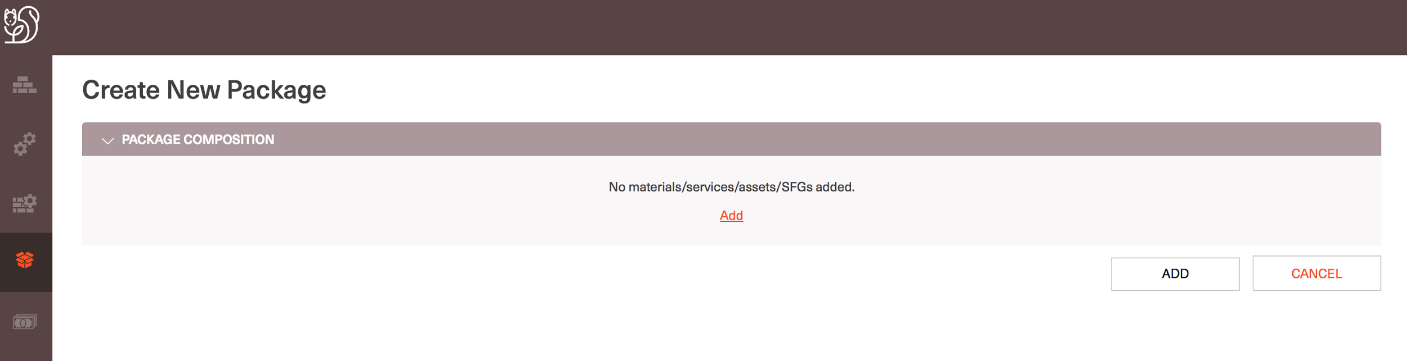

Slide 72


Slide 73
Cost of a Package
Log into CL and navigate to Package homepage
Navigate to a Package details page
Package Cost = Sum of Cost of all the components that are associated with an Package
Cost of each component = Average Landed Rate of the component * Coefficient of the component for the Package
Average Landed Rate of a component = Average of landed rate in all the mode of purchases in a given location and on a specified date.
To View cost of an Package, user should navigate to the required Package details page
In the composition section on the right corner of the section, define the Location and Date for which the Cost of the Package is required
Accordingly the Cost of the Package is calculated and displayed along with the breakup of the Cost for each component

Slide 74


Slide 75


Slide 76
Update a Package Details
Log into CL and navigate to Package homepage
Navigate to a Packages details page
Select on the ‘Edit’ button on the top right corner of the page
All the Package properties are editable
Users can update the Package properties and submit
Users cannot add or remove components from Package details once created
Users can still change the coefficient values of the components associated with a Package

Slide 77


Slide 78
Exchange Rates
View current applicable exchange rates
Login to CL and Navigate to the ‘Exchange Rates section
Users are Navigated to the Current applicable Exchange rates page
View Exchange rate history
Users can select ‘ View Exchange Rate History’ option on the Exchange rates homepage
Users are navigated to the Exchange rate history page where Past, present and future versions of the Exchange rate for different currency types are displayed
CL handles exchange rates from any currency type to INR
Define Exchange rate version
User can select on ‘Add new’ on the Exchange rate history page and add a new Exchange rate version for specific currency type
User should be able to define for which currency they wish to setup INR exchange rate, with the respective Conversion risk factor and applicable from date

Slide 79

View current applicable exchange rates

Slide 80

View Exchange rate history

Slide 81

Define Exchange rate version

Slide 82
Cost to Price Ratio (CPR)
View CPR for a group of components
View CPR for a specific component under a group
View project specific CPR values setup in a group of components
Setup CPR for a group of components
Setup CPR for a specific component
Setup project exception CPR values

Slide 83
CPR (Cost-to-Price Ratio)

Slide 84
View CPR for a group of components/Specific component
Login to CL and Navigate to PriceBook section
Users will be navigated to the CPR page as CPR is only developed as part of PriceBook
View CPR for a group of components
Users can specify the group of components they wish to view CPR for: Materials/Services/SFGs/Packages
Users then further narrow the group of components they wish to look for CPR values based on the Classification properties
For Materials: Users have to select the Classification level 1 value to view all the values setup at level 2 and level 3
For Services/SFGs/Packages: Users will be directly navigated to all the CPR values setup at Classification level 1 and level 2
Users can also filter CPR values based on the Applicable date accordingly the respective version of CPR is shown in the results
View CPR for a specific component under a group
Given user is able to view CPR for a group of item, they will also be shown of the specific component exceptions in a group
Specific component exceptions are displayed with component code and the CPR setup for the respective component (Material/Service/SFG/Package)

Slide 85


Slide 86


Slide 87


Slide 88

View project specific CPR values setup in a group of components
Users are by default shown CPR values that are applicable globally in TE
For viewing the Project specific CPR values, user should choose the respective project name in the dropdown and if there is project specific value setup for any component(s) in the specified group(s) the same shall be displayed along with the globally setup CPR value.

Slide 89
Setup CPR value for a group of components
Log into CL and navigate to PriceBook
Select the ‘+’ button at the right bottom of the CPR View page
Users shall be navigated to a pop-up screen to add a new CPR version onto CL DB
User can define the ‘Resource type’ and ’Group of components’ (For Materials defining Classification level 1 and 2 values are mandatory, For Services/SFGs/Packages defining Classification level 1 value is mandatory) to specify for which group of components they wish to add new CPR version
User can define the ‘Applicable from’ date to define from when the new version of CPR is applicable.
Similar to the case of Rate for components CPR also cannot be setup for past dates.
Users can define all the CPR coefficient values and submit CPR
Similar to the case of Rate for components, on a given date only one version of CPR should be setup for the same group of components. CL application will not allow users to create a new version on the same date for a group of components.

Slide 90


Slide 91
Setup CPR value for a specific Component
Log into CL and navigate to PriceBook
Select the ‘+’ button at the right bottom of the CPR View page
Users shall be navigated to a pop-up screen to add a new CPR version onto CL DB
User can define the ‘Resource type’ and specify the ‘Component code’ for which the new CPR version needs to be created
User can define the ‘Applicable from’ date to define from when the new version of CPR is applicable.
Similar to the case of Rate for components CPR also cannot be setup for past dates.
Users can define all the CPR coefficient values and submit CPR
Similar to the case of Rate for components, on a given date only one version of CPR should be setup for the given component. CL application will not allow users to create a new version on the same date for a given component.

Slide 92


Slide 93
Setup CPR value for a specific Component as a Project Exceptions
Project Exceptions are allowed to be specified at component level and not to a group of components
Log into CL and navigate to PriceBook
Select the ‘+’ button at the right bottom of the CPR View page
Users shall be navigated to a pop-up screen to add a new CPR version onto CL DB
User can define the ‘Resource type’ and specify the ‘Component code’ for which the new CPR version needs to be created
Define the ‘Project’ for which the CPR version is applicable by selecting the project name from the drop-down.
User can define the ‘Applicable from’ date to define from when the new version of CPR is applicable.
Similar to the case of Rate for components CPR also cannot be setup for past dates.
Users can define all the CPR coefficient values and submit CPR
Similar to the case of Rate for components, on a given date only one version of CPR should be setup for the given component at a project. CL application will not allow users to create a new version on the same date for a given component at a project.

Slide 94


